Slide 1
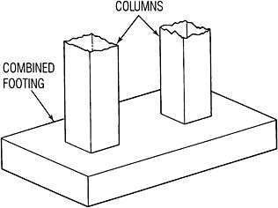
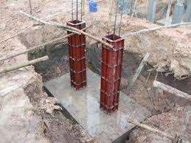
PART A
DESIGN OF RCC STRUCTURES
Chapter 1
DESIGN OF COMBINED FOOTINGS

Slide 2
Combined footings are constructed for two or more columns when they are close to each other and their foundations overlap.
Combined | footings are | provided
only when
1. When | two columns | are close
together, causing overlap of adjacent isolated footings
Where soil bearing capacity is low causing overlap of adjacent isolated footings.
Proximity of building line or existing building or sewer, adjacent to building column.

Slide 3
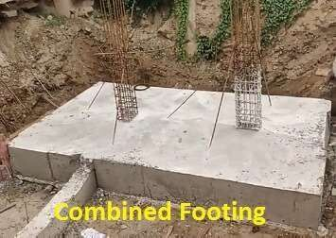
The main purpose of using combined footing is to distribute uniform pressure under the footing.
To achieve this , the center of gravity of the footing area should coincide with the center of gravity of the two columns loads.

Slide 4
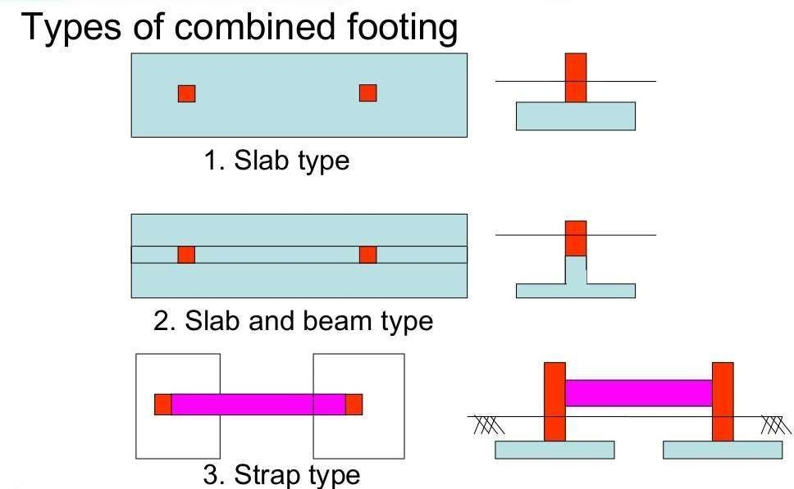
Following are the different types of combined footing
Slab type combined footing
Slab and Beam type combined footing
Strap type Combined footing.
9

Slide 5
Design a combined footing for two RCC columns A and B separated by distance of 4 m c/c, Column A is 500 x 500 and carries a load of 1250 KN and Column B is 600 x 600 and carries a load of 1600 KN. Take SBC of soil as 200 KN/m² . Use M20 concrete and Fe415 Steel. Draw the rough sketches of the following
Sectional Elevation
Plan of bottom reinforcements
Plan of top reinforcements
Cross Section of two different places to show the maximum details of shear reinforcements.
Data Given :
Size of Column A = 500 x 500 mm Load on Column A W1 = 1250 KN Size of Column B = 600 x 600 mm Loan on Column B W2 = 1600 KN
2
SBC of Soil = 200 KN/m
fck = 20 KN/m² fy = 415KN/m²
Soln:
1. Size of the Footing:
Total Column Load =
1250 + 1600 = 2850 KN
Self Wt. of Footing = 10 % of Column Load = 285 KN
Total load = 3135 KN

Slide 6
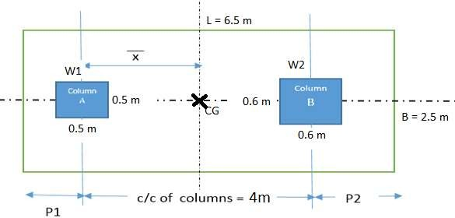
Area of footing L X B =
𝑇𝑜𝑡𝑎𝑙 𝐿𝑜𝑎𝑑
=
3135
𝑆𝐵𝐶 𝑜𝑓 𝑆𝑜𝑖𝑙
200
Af = L x B = 15.675 m²
Assume the Width of the footing between 1.5 m to 2.5 m Take B = 2.5 m
L x B = 15.675
L =
15.675
= 6.27 m say 6.5 m
6.5 m x 2.5 m
2.5
∴ Provide L x B =
2. Projections p1 & p2:
Projections should be such that the center of gravity of column loads should coincide with the center of the footing.

Slide 7
∴ CG of footing from the center of the Column A
x̄ =
(𝑊1∗𝑥1 ) + (𝑤2∗𝑥2)
(𝑊1+𝑊2)
=
(1250∗0 ) + (1600∗4)
(1250+1600)
x̄ = 2.24 m
From the above diagram ,we can write
p1 + 2.24 = L/2 p1 + 2.4 = 6.5/2
p1 = 1 m Also p1 + 4 + p2 = L
1 + 4 + p2 = 6.5 p2 = 1.5 M
∴ Projections p1 = 1 m and p2 = 1.5 m
3. Shear force and Bending Moment Diagram: (SFD & BMD):
Net Upward Pressure / m² q =
𝑂𝑛𝑙𝑦 𝐶𝑜𝑙𝑢𝑚𝑛 𝑙𝑜𝑎𝑑
𝑎𝑟𝑒𝑎 𝑜𝑓 𝑓𝑜𝑜𝑡𝑖𝑛𝑔
=
2850
6.5∗2.5
q = 175.4 KN/m²
q = q x B
Net Upward Pressure/ m
o

Slide 8
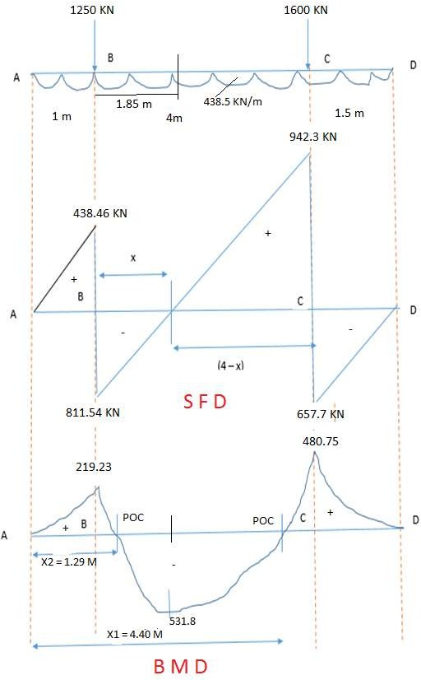
= 175.4 * 2.5
= 438.5KN/m

Slide 9
Shear Force Calculation:
SF at A = 0
SF up to B SF at B SF up to C Sf at C
= + 438.5 * 1 = 438.46 KN
= + 438.5 – 1250 = - 811.54 KN
= - 438.5 *1.5 = - 657.7 KN
= - 657.7 + 1600 = + 942.3 KN
SF at D = 0
Bending Moment Calculation:
BM at A | = 0
BM at B | = | + 438.46 * 1 *1/2 = + 219.23 KN-m
BM at O | = | + 438.46*2.85*2.85/2 -1250*1.85 = - 531.80 KN-m
BM at C | = | + 438.46*5*5/2 – 1250*4 = + 480.75 KN-m
BM at D | = | 0
Location of Zero Shear Force:
The point where SF=0, the BM is maximum
From Shear force diagram, from two similar triangles, we can write
811.54 942.3
=
𝑥 (4−𝑥)
∴ x = 1.85 m
i.e Shear force is zero at a distance of 1.85 m from B.

Slide 10
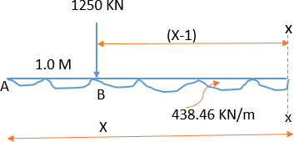
Location of POC’s:
POC is the point where BM changes its sign Therefore equating BM at x-x = 0
438.46 * x *x /2 – 800 (x-1) = 0
219.23 *x² -1250* x + 1250 = 0
Solving Quadratic equation, x₁ = 4.10 m & x₂ = 1.5 m
4. Design of Slab:
Provide width of Beam is equal to size of bigger column
∴ Beam width = 600 mm

Slide 11
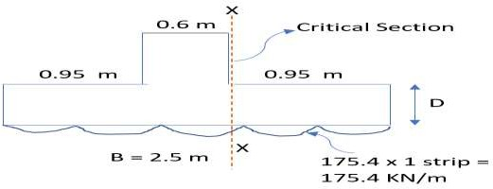
Taking moment about Critical Section x - x
∴ M = 175.4*0.95* ^{0.95} = 79.15 KN-m
2
Mu = 1.5 *M = 1.5 *79.15 = 118.72 KN-m
Thickness or Depth of Slab: Equating Mu to Mulimit
𝑥 𝑥
M = 0.36
𝑢,𝑚𝑎𝑥
𝑢,𝑚𝑎𝑥
u
[1 − 0.42 ] 𝑓 𝑏 𝑑²
𝑑 𝑑
𝑐𝑘
118.72 * 10⁶ = 0.36 ∗ 0.48[1 − 0.42 ∗ 0.48] ∗ 20 ∗ 1000 ∗ 𝑑²
d = 207.4 mm
Using 60 mm effective cover
Overall depth D = 207.4 + 60 = 267 mm say 270 mm

Slide 12
But from shear consideration, double the above thickness
∴ D = 540 mm and d = 480 mm
Area of Steel:
Mu = 0.87 fy Ast d[1 −
Ast fy
]
fck b d
118.72 x 10⁶ = 0.87 ∗ 415 ∗ Ast ∗ 480[1 −
Ast∗415
]
20∗1000∗480
Ast = 706.62 mm²
Providing 12 mm dia bars, Spacing is taken least of the following
𝜋 ∗ 12²
i. Spacing = ^{𝑎𝑠𝑡} * 1000 = ∗ 1000 = 160 mm ii.
iii.
4
𝐴𝑠𝑡 706.62
Spacing = 3d = 3 * 480 = 1440 mm Spacing = 300 mm
∴ Provide 12mm dia bars @ 160mm c/c
Distribution Steel:
0.12
Ast = 0.12 % of Gross Area = * 1000 * 540 = 648 mm²
100
Providing 10 mm dia bar, Spacing is taken as least of the following
𝜋∗ 10²
i. Spacing = ^{𝑎𝑠𝑡} * 1000 = ii.
iii.
4
∗ 1000 = 121 𝑚𝑚 ≈ 120 𝑚𝑚
𝐴𝑠𝑡 660
Spacing = 5d = 5 * 480 = 2400 mm Spacing = 450 mm
∴ Provide 10mm dia bars @ 110 mm c/c

Slide 13
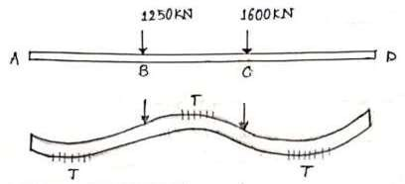
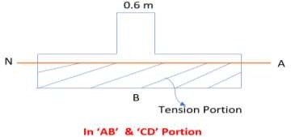
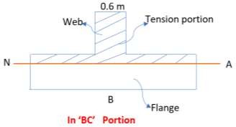
5. Design of Beams:
Beam Width b = 600 mm
AB and CD portion are designed as Rectangular Beam and BC portion is designed as T – Beam.

Slide 14
Concrete is very weak in tension, hence neglect the concrete portion in tension zone.
Mmax = 531.8 KN-m (From BM Diagram) Mu = 1.5 * 531.8 = 797.7 KN-m
Equating Mu to Mulimit
𝑥 𝑥
M = 0.36
𝑢,𝑚𝑎𝑥 𝑢,𝑚𝑎𝑥
u
[1 − 0.42 ] 𝑓 𝑏 𝑑²
𝑑 𝑑
𝑐𝑘
797.7 * 10⁶ = 0.36 ∗ 0.48[1 − 0.42 ∗ 0.48] ∗ 20 ∗ 600 ∗ 𝑑²
d = 694.14 say 700 mm
∴ Beam dimensions b = 600 mm, d = 700 mm and D = 760mm
(i) Design of “AB”Portion:
MAB = 219.23 KN-m. (From BM diagaram) Mu = 1.5 * 219.23 = 328.84 KN-m
In AB portion, tension is in the flange, hence neglecting tension zone, Take b = 600mm
Area of Steel:
Mu = 0.87 fy Ast d[1 −
Ast fy
]
fck b d
328.8 x 10⁶ = 0.87 ∗ 415 ∗ Ast ∗ 700[1 −
Ast∗415
]
20∗600∗700
Ast = 1397.6 mm²
Providing 20 mm dia bars,

Slide 15
𝐴𝑠𝑡
1397.6
No. of bars = =
𝑎𝑠𝑡
3.14∗ 20²
= 5 bars.
4
(ii) Design of “CD”Portion:
MCD = 480.75 KN-m. (From BM diagram) Mu = 1.5 * 480.75 = 721.12 KN-m
Even in CD portion, tension is in the flange, hence neglecting tension zone, Take b = 600mm
Area of Steel:
Mu = 0.87 fy Ast d[1 −
Ast fy
]
fck b d
721.12 x 10⁶ = 0.87 ∗ 415 ∗ Ast ∗ 700[1 −
Ast∗415
]
Ast = 3437 mm² Providing 25mm dia bars,
20∗600∗700
No. of bars = =
𝑎𝑠𝑡
𝐴𝑠𝑡 1397.6
= 7 bars.
3.14∗ 25²
4
(iii) Design of “BC”Portion:
MBC = 531.8 KN-m. (from BM diagram) Mu = 1.5 * 531.8 = 797.7 KN-m
In this portion, tension is in WEB, hence neglecting, web portion and considering flange
∴ b = bf = effective flange width
Hence beam is designed like a T- Beam

Slide 16
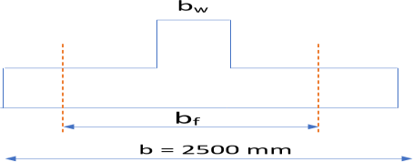
For Isolated T-Beam
Effective flange width b =
𝑙_{𝑜}
+ 𝑏 ----Page 37, IS 456
f
𝑙_{𝑜}
𝑤
( _{𝑏} )+4
b = Actual flange Width = 2500
𝑙_{𝑜} = Distance between points of zero moments
𝑙_{𝑜} = Distance between POC
= (x1 - x2) = 4.4 - 1.29 = 3.11 m = 3110 mm
From BMD
Therefore,
bf =
3110
+ 600 = 1193 mm
3110
( )+4
2500
Area of Steel:
Mu = 0.87 fy Ast d[1 −
Ast fy
]
fck 𝑏_{𝑓} d
797.7 x 10⁶ = 0.87 ∗ 415 ∗ Ast ∗ 700[1 −
Ast∗415
]
20∗1193∗700
Ast = 3453.5 mm²

Slide 17
Providing 25mm dia bars,
𝐴𝑠𝑡
3453.5
3.14∗ 25²
No. of bars = =
𝑎𝑠𝑡
= 7 bars.
4
Design of Beam for Shear:
Maximum shear force Vmax = 942.3 KN (From SFD )
Ultimate shear force = 1.5 * 942.3 = 1413.4 KN b = 600mm, d = 700 mm, Ast = 3453.5 mm²
Nominal Shear force τv =
𝑉𝑢 1413.4∗10³
=
= 3.36 N/mm
2
𝐵 𝑑 600∗700
Shear Stress in Concrete:( τc )
Pt =
100 𝐴𝑠𝑡
=
100 ∗3453.5
= 0.82
𝑏 𝑑
600∗700
Referring to IS 456, Pg 73, for Pt = 0.82 and M20 Concrete
∴ τc = 0.58 N/mm²
Comparing
τv and τc ,
τv > τc
, ∴ Provide Shear Reinforcement
Vertical Stirrups:
Using 4L - #10 mm Vertical stirrups
𝜋∗ 10²
A = 4 * = 314.16 mm²
sv
4
Shear force to be carried by vertical stirrups

Slide 18
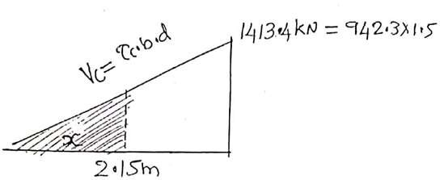
Vus = (Vu - τc * b*D) = (1413.4 * 10³ -0.58*600*700)
= 1169.83 kN
From IS 456, Page 73
Vus =
0.87 𝑓𝑦 𝐴𝑠𝑣 𝑑
𝑆𝑣
∴ Spacing of Vertical Stirrups from above equation
Sv =
0.87 𝑓𝑦 𝐴𝑠𝑣 𝑑
𝑉𝑢𝑠 0.87∗415∗314.15∗700
Sv =
1169.83∗10³
= 67.87 mm say 65 mm
Provide 4L – #10 mm Vertical Stirrups @ 65 mm c/c below the Column and @ 300 mm c/c in other places
o
Shear strength of Concrete at distance x from apex (from o) of above triangle
Vc = τc *b*d = 0.58 *600*700
= 243.6 KN

Slide 19
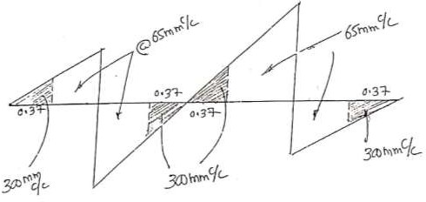
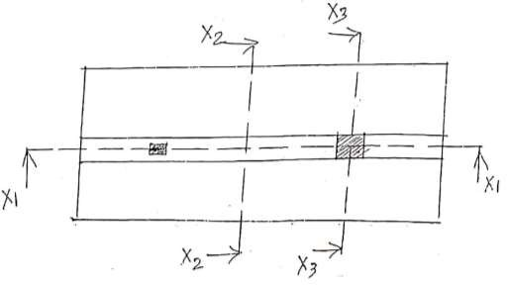
Distance x from above similar triangles
1413.4 ₌ 243.6
2.15 𝑥
∴
∴ x = 0.37 m.
Spacing of Stirrups:
Vertical Stirrups @ 65 mm c/c below the Column and @ 300 mm c/c in other places (0.37m from apex of the triangles)
Plan showing Slab, Beam and Column

Slide 20
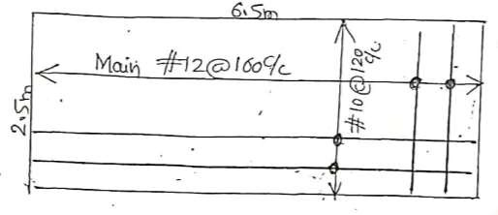
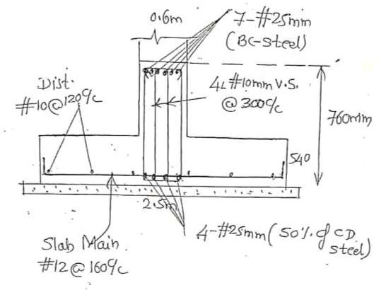
Plan showing reinforcement in slab
Cross Section at Mid span
(X2 – X2)

Slide 21
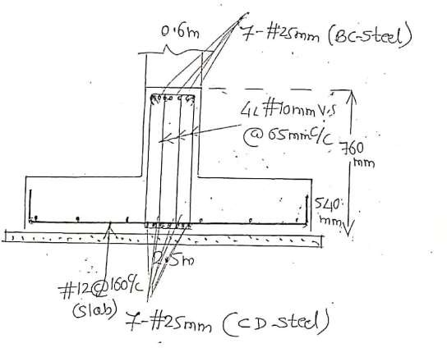
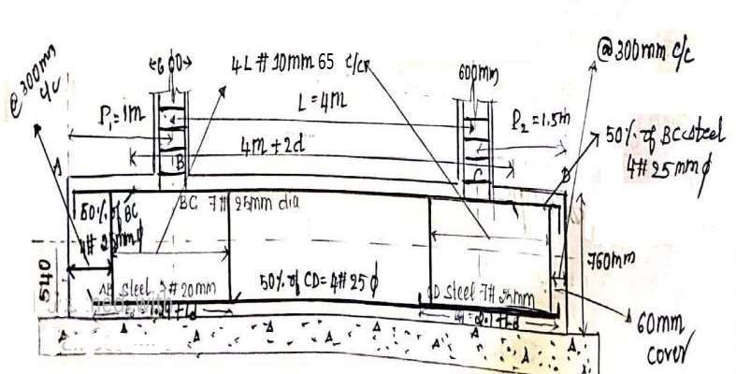
Cross Section through the Column (X3 – X3)
Longitudinal Cross Section (X1 –X2)

Slide 22
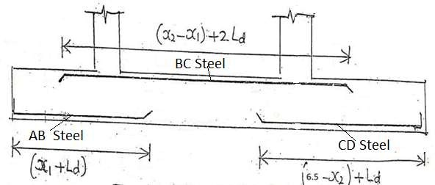
Ld = 47Ф for M25
Longitudinal Section showing reinforcement in beam

Slide 23
DESIGN OF WATER TANKS
(Working stress method using IS 3370 – Code of Practice for Concrete structure for the storage of liquids)
Following are the different types of water tanks to be designed
Design of circular water tank with rigid base.
Design of circular water tank with flexible base.
Design of rectangular water tank.
Working Stress Method:
a. Permissible Stresses in Concrete:
σcbc = Permissible Bending Compressive Stress in concrete.
σct = Permissible Tensile Stress in Concrete.
Grade of Concrete | σcbc | σct
M15 | 5 N/mm² | 1.10 N/mm²
M20 | 7 N/mm² | 1.20 N/mm²
M25 | 8.5 N/mm² | 1.30 N/mm²
b. Permissible Tensile Stresses in Steel:
σst = Permissible Tensile stress in Steel.
Grade of Steel | Near Water face | Away from Water face
Mild steel or Fe 250 | 115 N/mm² | 125 N/mm²
HYSD or Fe 415 or Fe 500 | 150 N/mm² | 190 N/mm²

Slide 24
c. Working Stress Constants:
Modular ratio m =
Neutral axis c0efficient k =
Lever arm constant
280
^{3𝜎}𝑐𝑏𝑐
𝑚 𝜎_{𝑐𝑏𝑐}
^{𝑚 𝜎}𝑐𝑏𝑐^{+ 𝜎}𝑠𝑡
j = 1 -
𝑘 3
iv. Moment of Resistance coefficient
𝜎_{𝑐𝑏𝑐} 𝑘 𝑗
Q =
2
Effective depth d = √
Area of Steel
𝑀
𝑄 𝑥 𝑏
If the moment is known Ast =
𝑀
𝜎_{𝑐𝑏𝑐} 𝑗 𝑑
If force is known Ast =
𝐹𝑜𝑟𝑐𝑒
^{𝜎}𝑠𝑡
d. Specifications for the design of Water Tank:
Adopt clear cover = 30 mm
Minimum reinforcement
Up to 100mm thick wall = 0.3% of Gross Area Between 100 & 450 mm thick wall = 0.2% of Gross Area
Thickness of wall (T)
T = 30 H + 50 mm, Where H = Depth of water in m
2.
σcbc =
𝑀𝑎𝑥𝑖𝑚𝑢𝑚 𝐻𝑜𝑜𝑝 𝑇𝑒𝑛𝑠𝑖𝑜𝑛
1000 𝑇+(𝑚−1)𝐴𝑠𝑡.
iv. w = Unit weight of water = 1000 N/m³
= 1 KN/m³
Also 1000 lts = 1 m³
∴ 1 lt = 1 * 10⁻³ m³

Slide 25
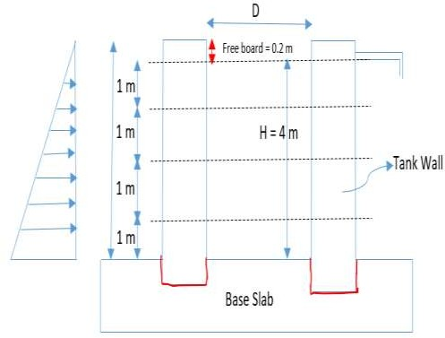
Design of circular water tank with flexible Base.
Design a circular water tank with flexible base for a capacity of 4 x 10⁵ lts. The depth of water tank is to be 4m with a free board of 200 mm. Use M25 and Fe 415 steel.
Draw the following sketches
Cross section of the tank
Half plan through the wall
Half plan through the base slab. Data given:
Capacity = 4 x 10⁵ lts. Depth H = 4m
Free board = 0.2 m
Take Unit weight of water = 9.81 KN/m³
= 981 N/m³

Slide 26
1. Design Constants
For M25, σcbc = 8.5 N/mm² , σct = 1.31 N/mm²
For Fe 415,
σst = 150 N/mm²
280
280
Modular ratio m = =
3∗8.5
= 10.98
^{3𝜎}𝑐𝑏𝑐
2. Dimensions of the Water Tank:
Equating capacity to volume
i.e. capacity = Volume
4 x 10⁵ lts. = Area * Height
4 x 105 𝜋
_{𝐷}2
* 4 m
m³=
1000 4
D = 11.28m say D = 11.3 m.
3. Hoop Tension ( in the bottom 1m height) Here H = 4 m from top
Maximum Hoop tension = W *H *
𝐷 2
= 9.81 * 4 *
11.3
2
= 221.70 KN
∴ Area of hoop tension steel, A
st
𝐹𝑜𝑟𝑐𝑒 𝑚𝑎𝑥.𝐻𝑜𝑜𝑝 𝑡𝑒𝑛𝑠𝑖𝑜𝑛
⁼ σst ⁼ σst
221.70∗ 10³
Ast = = 1478 mm²
150
Providing 16 mm dia bars
Spacing =
𝑎𝑠𝑡
𝜋∗ 16²
𝐴𝑠𝑡
∗ 1000 = ⁴ ∗ 1000 = 136.03 = 130 mm
1478
∴ Provide #16mm hoop tension steel @ 130 mm c/c in the bottom 1m height

Slide 27
4. Hoop Tension in 1m to 2 m from bottom: Here H = 3 m from top
Hoop tension = W *H1 *
𝐷 2
= 9.81 * 3 *
11.3
2
= 166.27 KN
∴ Area of hoop tension steel, A
st
𝐹𝑜𝑟𝑐𝑒 𝐻𝑜𝑜𝑝 𝑡𝑒𝑛𝑠𝑖𝑜𝑛
⁼ σst ⁼ σst
166.27∗ 10³
Ast = = 1108.46 mm²
150
Providing 16 mm dia bars
Spacing =
𝑎𝑠𝑡
𝜋∗ 16²
𝐴𝑠𝑡
∗ 1000 = ⁴ ∗ 1000 = 181.3 = 180 mm
1108.46
∴ Provide #16mm hoop tension steel @ 180 mm c/c between 1m to 2m from
bottom
5. Hoop Tension between 2m – 3m from bottom: Here H = 2 m from top
Hoop tension = W *H2 *
𝐷 2
= 9.81 * 2 *
11.3
2
= 110.85 KN
∴ Area of hoop tension steel, A
st
𝐹𝑜𝑟𝑐𝑒 𝐻𝑜𝑜𝑝 𝑡𝑒𝑛𝑠𝑖𝑜𝑛
⁼ σst ⁼ σst
110.85 ∗ 10³
Ast = = 739 mm²
150
Providing 16 mm dia bars

Slide 28
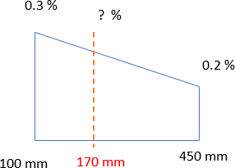
Spacing =
𝑎𝑠𝑡
𝜋∗ 16²
𝐴𝑠𝑡
∗ 1000 = ⁴ ∗ 1000 = 270 mm
739
∴ Provide #16mm hoop tension steel @ 270 mm c/c between 2m to 3m from
bottom
Wall Thickness: (T)
T = 30 H + 50 mm, Where H = Depth of water in m
= 30 * 4 + 50 mm = 170 mm
2.
σcbc =
𝑀𝑎𝑥𝑖𝑚𝑢𝑚 𝐻𝑜𝑜𝑝 𝑇𝑒𝑛𝑠𝑖𝑜𝑛
1000 𝑇+(𝑚−1)𝐴𝑠𝑡.
221.70 ∗ 10³
^{1.30 =} 1000 𝑇 + (10.98 − 1) ∗ 1478
T = 155.78 mm
∴ Take T = 170 mm
7. Steel for remaining top 1 m height: (between 3 to 4 m) For top 1m, provide minimum steel,
For 100 thick wall, Minimum steel For 450 thick wall, Minimum steel
= 0.3 % of gross area
= 0.2 % of gross area

Slide 29
∴ For 170 thick wall, Minimum steel
= 0.28 % of gross area
= 0.28/100 * (1000 *170)
= 476 mm²
Using 12 mm dia bars
Spacing =
𝑎𝑠𝑡
𝜋∗ 12²
𝐴𝑠𝑡
∗ 1000 = ⁴ ∗ 1000 = 237 say 230 mm
476
∴ Provide #12 mm hoop tension steel @ 230mm c/c from top 1m
7. Vertical Distribution Steel:
Area of steel
= 0.28 % of gross area
= 0.28/100 * (1000 *170)
= 476 mm²
Using 10 mm dia bars
Spacing =
𝑎𝑠𝑡
𝜋∗ 10²
𝐴𝑠𝑡
∗ 1000 = ⁴ ∗ 1000 = 164 say 160 mm
476
∴ Provide #10 mm @ 160 mm c/c as Vertical Steel.
8. Base slab Design (Floor slab):
Base slab is continuously supported on ground, therefore provide a minimum thickness of 150 mm and reinforcement of 0.3 % of steel in the form of mesh @ top and bottom
∴ Area of steel =
=
=
0.3% of Area 0.3/100 *(1000*150)
450 mm²
Using 10 mm dia bars

Slide 30
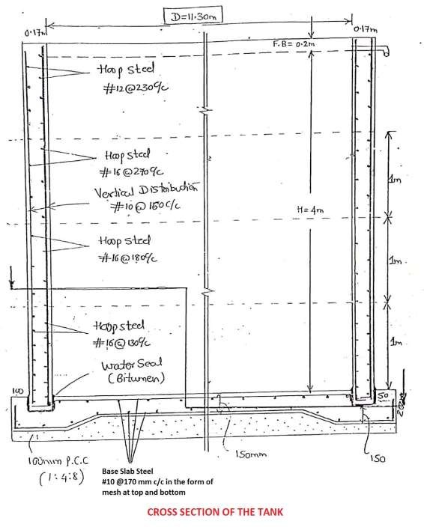
Spacing =
𝑎𝑠𝑡
𝜋∗ 10²
𝐴𝑠𝑡
∗ 1000 = ⁴ ∗ 1000 = 174.53 say 170 mm
450
∴ Provide #10 mm @ 170 mm c/c

Slide 31
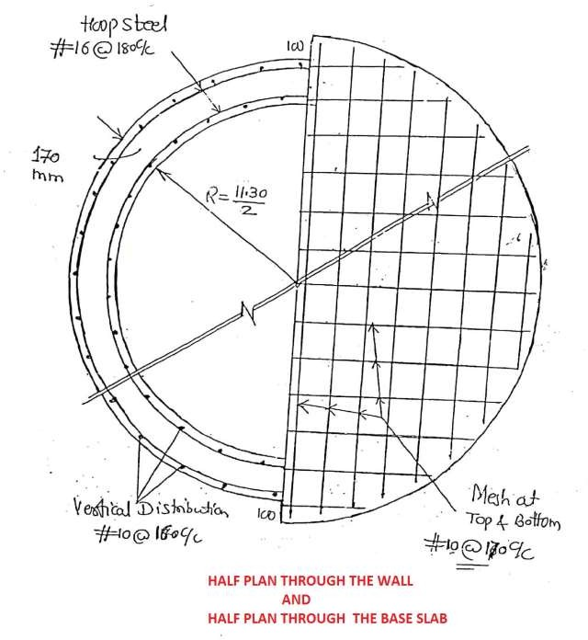

Slide 32
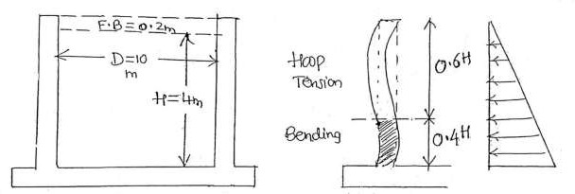
Design of Circular Water Tank with RIGID BASE
(Fixed or rigid base or restrained at the base)
Design a circular water tank of an internal dia 10 m and height 4m, the walls are restrained at the base. Use IS code method. Design the tank for M25 and Fe415. Draw sketches showing reinforcements
Cross section of water tank.
Draw half plan through wall.
Draw half plan through base slab.
Given Data:
Diameter = 10m, height = 4m, Assume free board = 0.2 m
1. Design Constants:
For M25, σcbc = 8.5 N/mm² , σct = 1.31 N/mm²
For Fe 415,
σst = 150 N/mm²
m =
280 280
= = 10.9
^{3𝜎}𝑐𝑏𝑐
3∗8.5
k =
𝑚 𝜎_{𝑐𝑏𝑐}
^{𝑚 𝜎}𝑐𝑏𝑐^{+ 𝜎}𝑠𝑡
=
10.98∗ 8.5
= 0.383
0.383
10.98∗8.5 + 150
j = 1 -
3
= 0.872
1

Slide 33
Q =
8.5∗0.383∗0.872
= 1.42
2
Thickness of Wall:
T = 30 H + 50 mm = 30*4 +50 = 170 mm
Using 50 mm Effective Cover, d = 170 – 50 = 120 mm
Hoop Tension and Bending Moment (Ring Tension): Hoop Tension:
From IS 3370 (Part IV) , Table-9, Page 35
Hoop Tension = Coefficient * H * 𝐷/2 *W (Kg/m)
_{𝐻}2 ₄2
Ratio = =
𝐷𝑇 10∗170
= 9.41
Search for the maximum values, it coincides at 0.6 H
For 8 – 0.578
10 – 0.602
By interpolating for 9.41 – 0.598 ≈ 0.6
∴ Hoop Tension = 0.6 *4 * 10/2 * 9.81 = 117.72 KN Bending Moment:
From IS 3370, Table 10, page 36
Moment = Coefficient * W *H³
_{𝐻}2 ₄2
Ratio = =
𝐷𝑇 10∗170
= 9.41
Search for the maximum values, it coincides at 1.0 H
2

Slide 34
For 8 – 0.0146
10 – 0.0122
for 9.41 – 0.0129
By interpolating
∴ Moment = Coefficient * W *H³ = 0.0129*9.81*4³
= 8.10 KN-m
Area of Steel:
a. Hoop Steel for Hoop Tension:
3
_{Ast =} 𝐻𝑜𝑜𝑝 𝑇𝑒𝑛𝑠𝑖𝑜𝑛 ₌ 118∗10 _{= 786.67 mm2}
𝜎𝑠𝑡 150
Providing 12 mm dia bars,
2
Spacing = ^{𝑎𝑠𝑡} * 1000=^{π∗12 /4} * 1000 = 140 mm
𝐴𝑠𝑡 786.67
∴ Provide 12mm dia bars @ 140 mm c/c up to a depth = 0.6 H =
2.4 m from bottom and 280 mm c/c for the remaining depth
b. Bending Moment or Cantilever Steel:
Ast =
𝑀 8.10 ∗ 10⁶
= = 459 mm²
𝜎𝑠𝑡∗𝑗∗𝑑 150∗0.872∗135
T = 170 mm, Using 10 mm bar and 30 mm clear cover d = 170 – 30 – 10/2 = 135 mm
Check for minimum Steel
Min Steel = 0.3 % of Gross area, for T = 100 mm
= 0.2 % of Gross area, for T = 450 mm For T = 170 mm Min Steel = 0.28 % of Gross area
3

Slide 35
∴ Ast = 0.28/100 * 1000 * 170 = 476 mm²
Providing 10 mm dia bars,
2
Spacing = ^{𝑎𝑠𝑡} * 1000=^{π∗10 /4} * 1000 = 160 mm
𝐴𝑠𝑡 476
∴ Provide 10mm dia bars @ 160 mm as Cantilever steel up to a height of 0.4*H = 1.6m ( or 4 – 2.4 = 1.6 m) from bottom
c. Vertical Distribution Steel:
Area of steel = 0.28 % of Gross Area
∴ Ast = 0.28/100 * 1000 * 170 = 476 mm²
Providing 8 mm dia bars,
2
Spacing = ^{𝑎𝑠𝑡} * 1000=^{π∗8 /4} * 1000 = 100 mm
𝐴𝑠𝑡 476
∴ Provide 8 mm dia bars @ 100 mm
5. Base Slab Design:
Provide 150 mm thick slab with 0.3% of Gross area of steel in the form of mesh @ top and bottom.
Area of steel = 0.3 % of Gross Area
∴ Ast = 0.23/100 * 1000 * 150 = 450 mm²
Providing 10 mm dia bars,
2
Spacing = ^{𝑎𝑠𝑡} * 1000=^{π∗8 /4} * 1000 = 170 mm
𝐴𝑠𝑡 476
∴ Provide 10 mm dia bars @ 170 mm c/c in the form of mesh
4

Slide 36
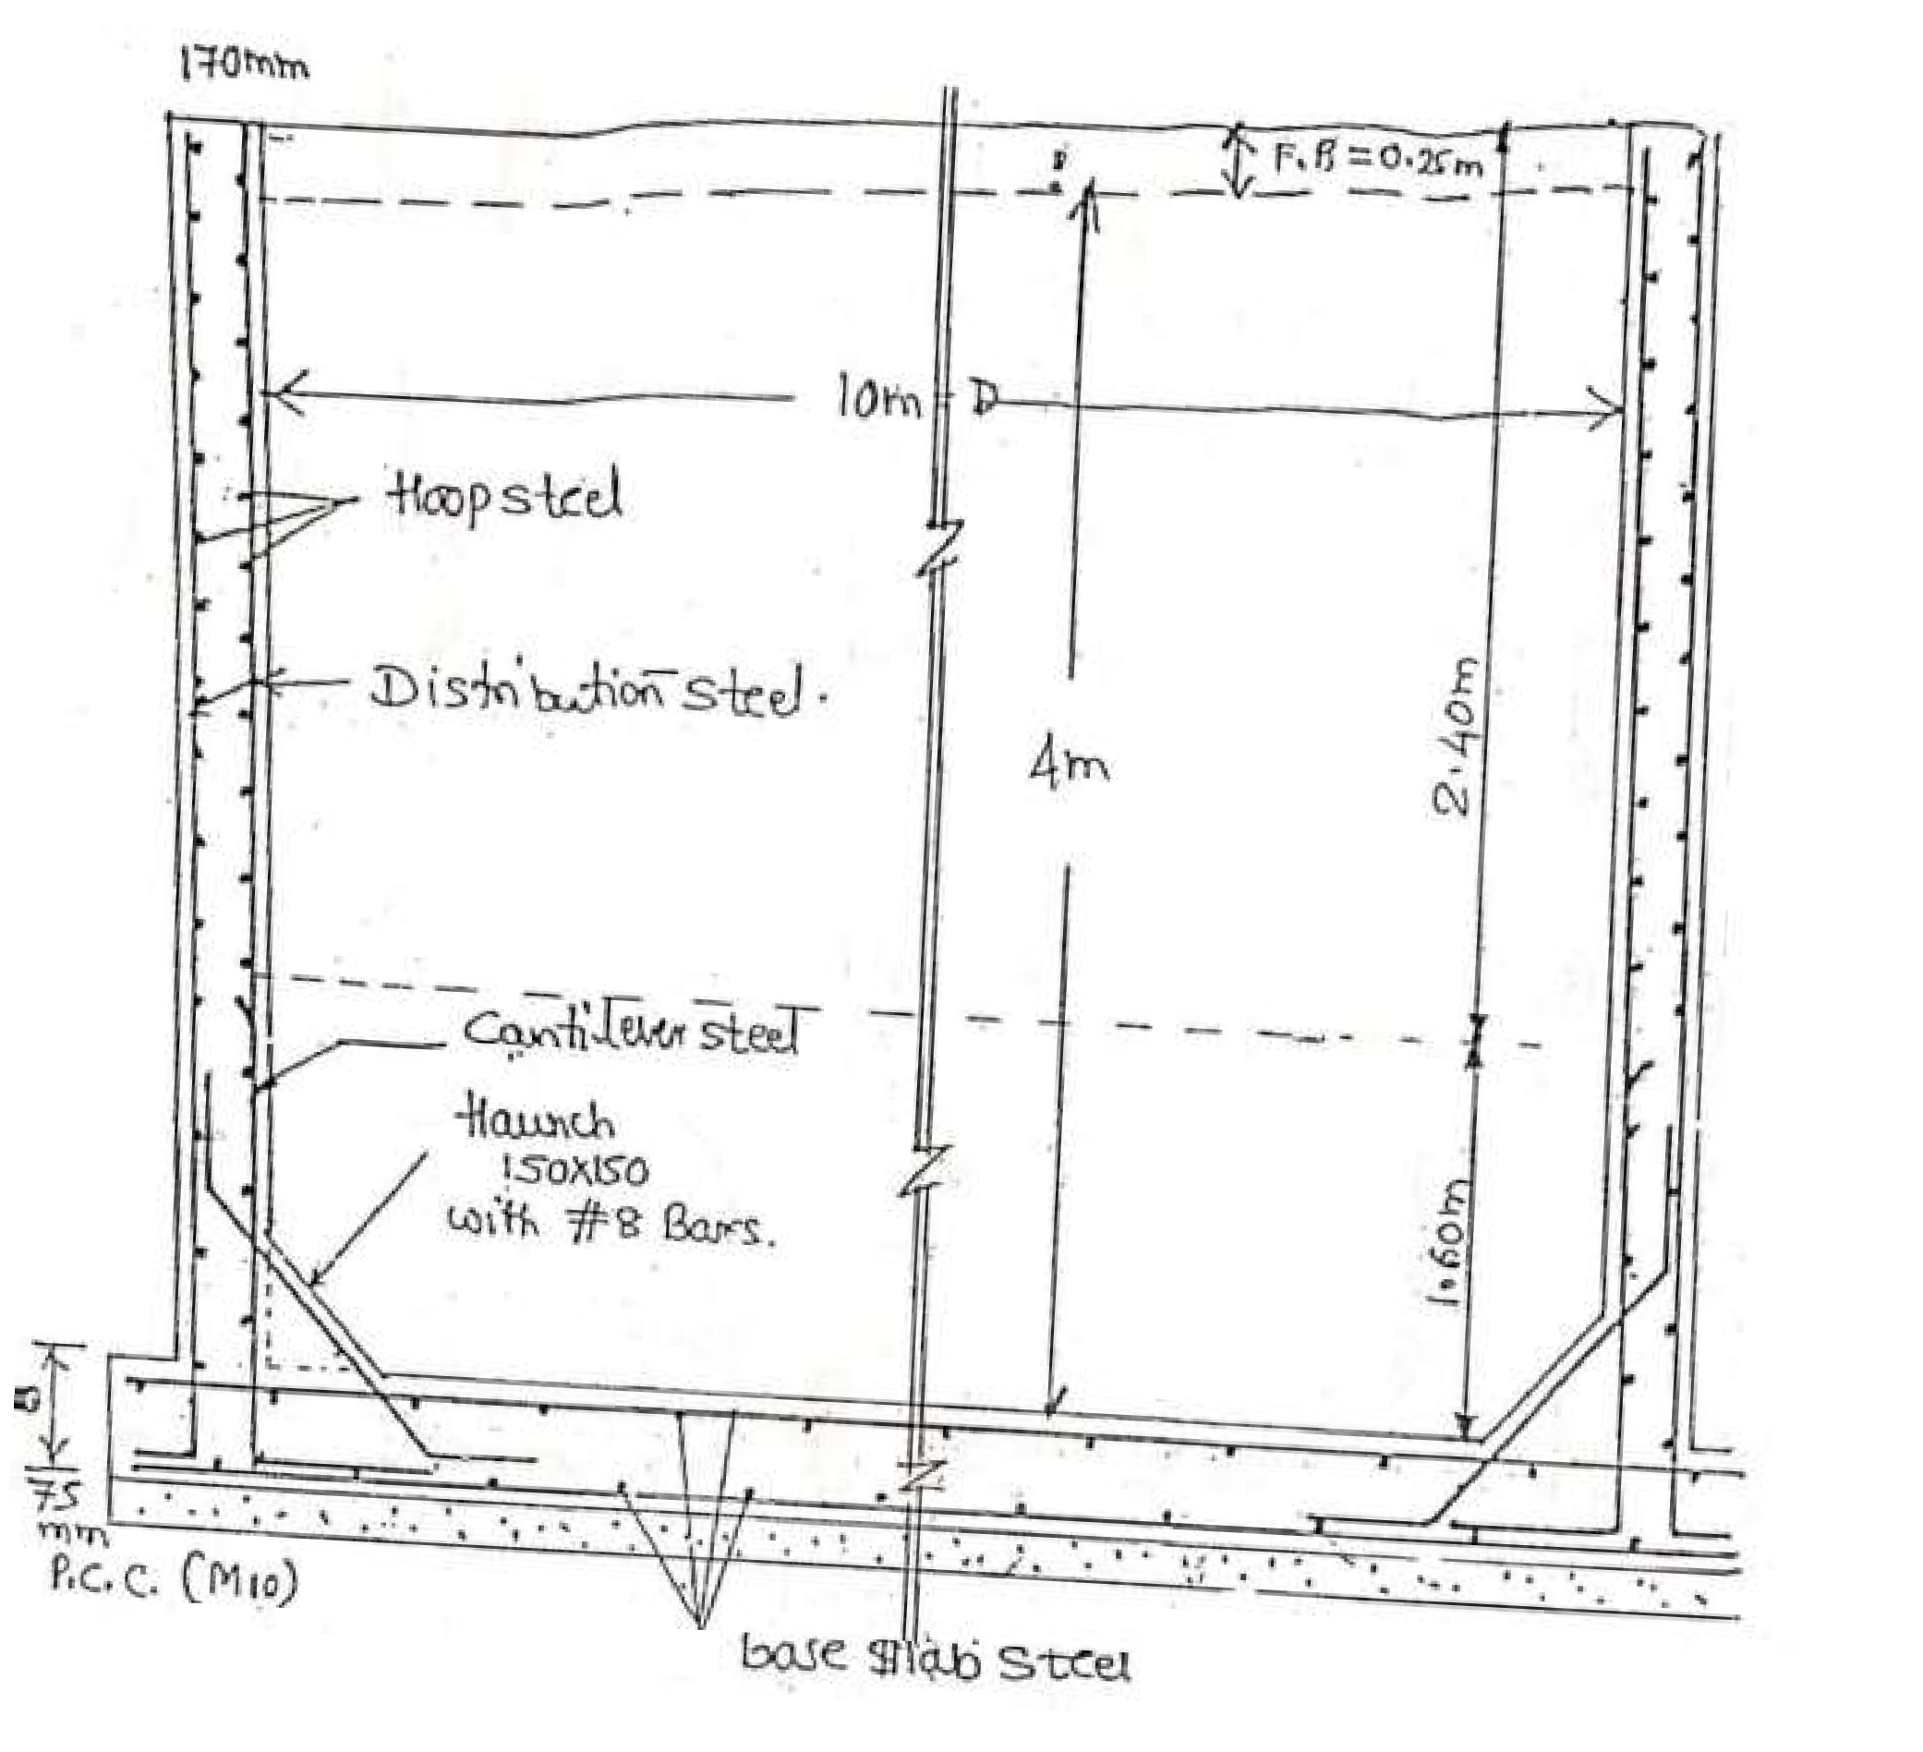
Also provide haunch 150 mm x 150 mm with 8mm dia bars @ 200 mm c/c
Cross Section of Water Tank (fixed)
5

Slide 37
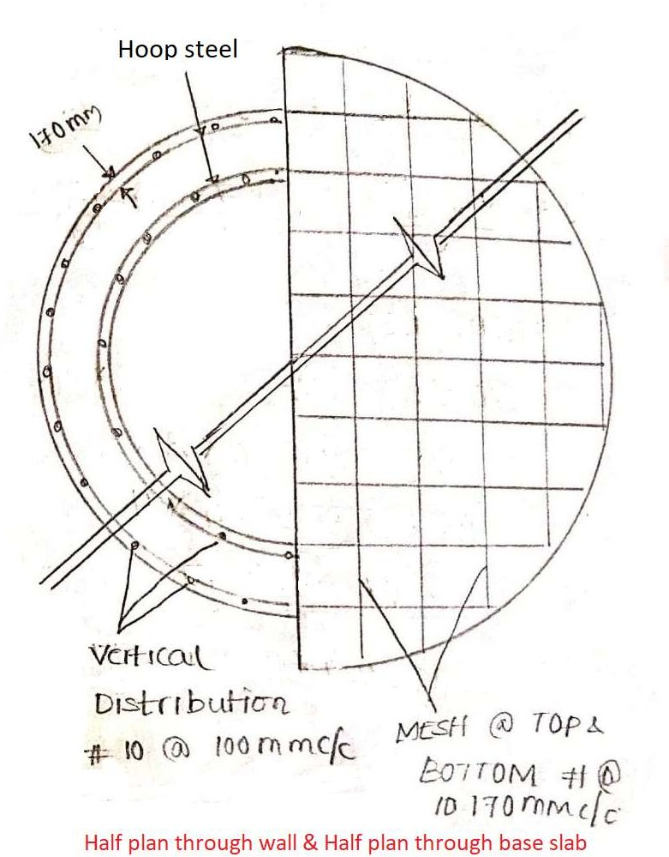
6

Slide 38
Design a circular water tank 12 m dia, 4 m height, the tank rests on ground, the wall is fixed on a base slab. Use M20 concrete and Fe 415 steel. Adopt working stress method and design as per 3370. Also draw the following sketch
Section through the tank.
Base slab reinforcement at top and bottom.
7

Slide 39
Design of Rectangular Water Tank ( By using IS 3370 –Part(4)
1. A rectangular water tank with an open top is required to store 80,000 lts of water. The inside dimension of the tank may be taken as 6 x 4 m. Design the side wall of the tank using M20 Concrete and Fe415 steel. Use IS method. Also draw
a.
b.
c.
Given Data:
Sectional plan of the tank Longitudinal section of the tank Cross Section of the tank.
Capacity = 80,000 lts
Inside dimension L = 6m, B = 4m
1. Design Constants:
For M20 For Fe415
^{𝜎}𝑐𝑏𝑐 ⁼
7 N/mm² 𝜎_{𝑐𝑡} = 1.2 N/mm²
^{𝜎}𝑠𝑡
= 150 N/mm²
i. Modular ratio
m =
280
=
280
3∗7
= 13.33
^{3𝜎}𝑐𝑏𝑐
ii. Neutral axis coefficient k =
𝑚 𝜎_{𝑐𝑏𝑐}
^{𝑚 𝜎}𝑐𝑏𝑐^{+ 𝜎}𝑠𝑡
=
13.33∗7
= 0.383
(13.33∗7+ 150
iii.
0.383
Lever arm constant j = 1 -
iv. Moment of Resistance coefficient Q =
= 0.8723
3
7∗ 0.38∗0.87
= 1.16
2
Page1

Slide 40
Equating Capacity to volume
i.e. Capacity = Volume 80,000 lts = Area * Height
80 m³ = L * B * H
80 = 6 * 4 * H H = 3.33 m
Providing 0.17 m as free board, H = 3.33 + 0.17 = 3.5 m
L = 6 m
B=4 m
Free board
Short wall
H = 3.5 m
Long Wall
Long wall Corner
Moment Calculation:
Moment Calculation for long wall: As per IS 3370, table 3,
Horizontal moment Vertical moment
= My w a³
= Mx w a³
a = height of the wall
= 3.5 m
Page2

Slide 41
b = Width of wall
∴ Ratio = b/a = 6/3.5 = 1.71
= 6 m
Mx For 1.75 …………… 0.074
For 1.71 ?
For 1.5 …………… 0.060
My
0.052
?
0.044
Select the Max Coefficients
∴ By interpolating for 1.71 Mx = 0.0719 & My = 0.051
∴ Horizontal moment = 0.051 * 10 * 3.5³ = 21.86 KN-m
∴ Vertical moment = 0.071 * 10 * 3.5³ = 30.87 KN-m
ii)
Moment calculation for short Wall: a = height = 3.5 m, b = 4 m Ratio b/a = 4/3.5 = 1.14
Mx For 1.25 …………… 0.047
For 1.14 ?
For 1.0 …………… 0.035
My
0.037
?
0.029
Select the Max coefficients
∴ By interpolating for
∴ Horizontal moment
∴ Vertical moment
1.14, Mx = 0.042 & My = 0.033
= 0.033 * 10 * 3.5³ = 14.14 KN-m
= 0.042 * 10 * 3.5³ = 18 KN-m
Page3

Slide 42
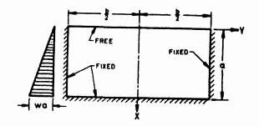
iii)
Moment for long wall Corner:
a = height = 3.5 m, b = 6 m Ratio = b/a = 6/3.5 = 1.71 Also y = b/2
From IS 3370, table 3,
 | Mx | My
For 1.75 …………… | 0.01 | 0.052
For 1.71 | ? | ?
For 1.5 …………… | 0.009 | 0.044
Select the Max coefficients
∴ By interpolating for 1.71, Mx = 0.009 & My = 0.050 Neglect Mx value since coefficient is very small
Horizontal moment = My w a³ = 0.050 * 10 * 3.5³ = 21.437 KN-m
Page4

Slide 43
3. Tank wall thickness:
Maximum Bending moment = 30.87 KN-m
∴ Effective depth d = √ ^{𝑚}
_{= √}30.87∗ 10⁶
= 163.12 mm
𝑄∗𝑏 1.16∗1000
Providing 50mm effective cover D= 63.13 + 50 = 213.13 ≈ 220 mm
∴ Provide D = 220 mm & d = 170 mm
Pull in each Wall:
Pull in long wall = ^{𝑤𝐻𝐵} = ^{10∗3.5∗4} = 70 KN
2 2
Pull in short wall = ^{𝑤𝐻𝐿} = ^{10∗3.5∗6} = 105 KN
2 2
Design of long wall:
X
220
X = (170 - )
2
50
= 60 mm
d = 170
220
Page5

Slide 44
i. Hoop steel or Horizontal Steel:
Ast =
𝑀−𝑇.𝑥 ₊ 𝑇
𝜎𝑠𝑡 .𝑗.𝑑 𝜎𝑠𝑡
where M = Horizonal Moment = 21.86 KN-m,T = 70 KN
9 3 3
_{Ast =} 21.86∗ 10 (70∗10 ) ₊ 70∗10
150∗0.87∗170 150
Providing 16 mm dia bars,
= 1263 mm²
2
Spacing = ^{𝑎𝑠𝑡} * 1000=^{π∗16 /4} * 1000 = 160 mm
𝐴𝑠𝑡 1263
∴ Provide 16 mm dia bars @ 160 mm c/c
ii. Vertical Steel
Ast =
𝑀
𝜎𝑠𝑡 .𝑗.𝑑
Ast =
30.87∗ 10⁹
= 1392 mm²
150∗0.87∗170
Providing 12 mm dia bars,
2
Spacing = ^{𝑎𝑠𝑡} * 1000=^{π∗12 /4} * 1000 = 81.24 mm say 80 mm
𝐴𝑠𝑡 1392
∴ Provide 12 mm dia bars @ 80 mm c/c
6. Design of Short Wall:
i. Hoop steel or Horizontal Steel:
Ast =
𝑀−𝑇.𝑥 ₊ 𝑇
𝜎𝑠𝑡 .𝑗.𝑑 𝜎𝑠𝑡
where M = Horizonal Moment = 14.14 KN-m, T = 105 KN
6 3 3
_{Ast =} 14.14∗ 10 (105∗10 ) ₊ 105∗10
150∗0.87∗170 150
= 1054 mm²
Page6

Slide 45
Providing 16 mm dia bars,
2
Spacing = ^{𝑎𝑠𝑡} * 1000=^{π∗16 /4} * 1000 = 190 mm
𝐴𝑠𝑡 1054
∴ Provide 16 mm dia bars @ 190 mm c/c
ii. Vertical Steel:
Ast =
𝑀
𝜎𝑠𝑡 .𝑗.𝑑
Ast =
18∗ 10⁶
= 811.35 mm²
150∗0.87∗170
Providing 12 mm dia bars,
2
Spacing = ^{𝑎𝑠𝑡} * 1000=^{π∗12 /4} * 1000 = 139.2 mm say 140 mm
𝐴𝑠𝑡 811.35
∴ Provide 12 mm dia bars @ 140 mm c/c
7. Design of Corner Wall :
Ast =
𝑀
𝜎𝑠𝑡 .𝑗.𝑑
Ast =
21.43∗ 10⁶
= 966 mm²
150∗0.87∗170
Providing 16 mm dia bars,
2
Spacing = ^{𝑎𝑠𝑡} * 1000=^{π∗16 /4} * 1000 = 200 mm
𝐴𝑠𝑡 966
∴ Provide 16 mm dia bars @ 200 mm c/c
Page7

Slide 46
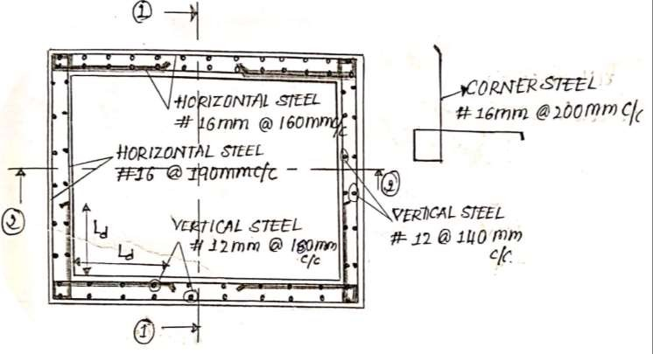
8. Design of Base Slab:
Provide minimum thickness = 150 mm
Also provide minimum steel in the form of mesh at the top and bottom = #10 @150 mm c/c.
Sectional Plan of the tank
Page8

Slide 47
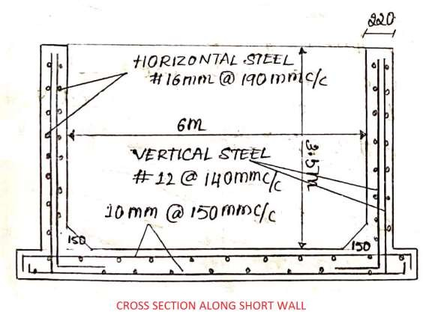
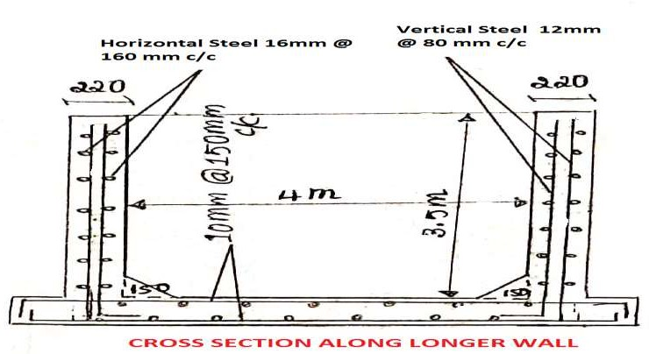
Page9

Slide 48
A rectangular water tank with an open top is required to store 1,00,000 lts of water. The inside dimension of the water tank may be taken as 8 m x 4m. The tank rests on ground. Design the side walls of the tank using the following
Permissible Compressive stress in concrete = 7 N/mm² Permissible Tensile stress in steel = 150 N/mm² Modular ratio = 13.33
Draw the following sketches.
Sectional elevation through short wall.
Sectional elevation through long wall.
Sectional plan. Solution:
Following are steps in the design
Design Constants and height of the tank
Moment Calculation
Moment calculation for long wall
Moment calculation for short wall
Moment calculation for long wall corner.
Tank wall Thickness
Pull in each wall
Design of long wall
Design of short wall
Design of corner wall
Design of base slab
Design side walls of rectangular reinforced water tank of dimensions 6m x 2 m having a maximum depth of 2.5m using M20 grade concrete and Fe 415 HYSD bars.
Draw a sketch of
Sectional plan of the tank
Longitudinal section of tank
Cross section of the tank.
Page10

Slide 49
HINGED PORTAL FRAME

Slide 51
HINGED PORTAL FRAMES
Problem
An RCC portal frame with a hinge base is required to suit the following data Spacing of portal frames = 4m c/c
Height of columns = 4m
Distance between column centres=10m Live load on the roof = 1.5kN/m²
The RC slab is continuous over portal frames SBC of soil = 200kN/m²
Materials M20 and Fe 415 steel.
Design the slab, portal frame and foundations. Draw to a suitable scale
Sectional elevation of half frame showing the details of reinforcement in footing, column and beam of portal frame.
Transverse section of beam and column
Sectional plan of footing and column
i)
Design:-
Design of continous slab
Effective depth = = = 153.85mm
Assume 0.3% tension reinforcement, modification factor 1.4 Hence effective depth = = 109.9mm
Assume a clear cover of 20mm and 10mm diameter bars. Total depth = 109.9+20+ = 134.9mm say 150mm

Slide 52
Dead load on the slab = 0.15X24 = 3.6kN/m²
Roof finishes = 0.756kN/m²
Ceiling finishes = 0.256kN/m² Dead load/m² g = 4.6kN/m²
Live load/m² q = 1.5kN/m²
Maximum Negative BM
M = +
M = 4.6 x + 1.5 x M = 10.03kN-m
Maximum Positive BM
M = +
M = 4.6 x + 1.5 x M = 8.53kN-m
Factored design moment = 1.5x10.03=15kN-m Assuming an effective depth as 0.9 times the total depth,
Ultimate resisting moment = = 50.3kN-m>15kN-m, Hence ok. Effective depth provided = 150-20-(10/2) =125mm
Design of reinforcement at top and bottom:-
15x10⁶=0.87x415xA_{st}x125 (1 - )

Slide 53
1.66x10⁻⁴Ast²-A_{st} +332.36=0
Ast=353mm²
Spacing of #10 = *1000= 222.5mm
Use #10 @ 200mmc/c
Distribution Steel:-
Ast== x 1000x150 = 180mm²
Spacing of #8 = *1000= 279mm
Use #8 @ 250mmc/c
Design of Portal Frame
Effective span of beam = 10m
Effective depth of the beam =
to
= 833.33mm to 666.7mm
Effective depth = 700mm
Overall depth= 750mm Width of beam = 450mm
Load on frame
Load from the slab = (4.6+1.5)x4x1 = 24.4kN/m Self-weight of beam = 0.45x0.63x1x25 = 7.1kN/m Self-weight of finishes = 0.5kN/m
Load/m = 32kN/m
Height of centre line of beam above hinge, h = (4+0.10-0.5x0.75) = 3.72 m

Slide 54
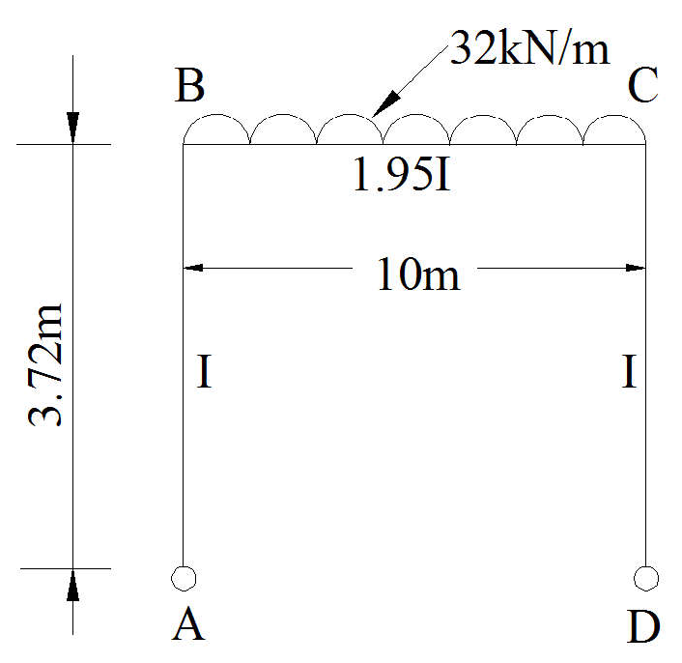
AB = 3.72m;
BC = 10m
I_{AB} =
= 8.1x10⁹mm⁴
I_{BC} = = 1.58x10¹⁰mm⁴
I_{AB} : I_{BC} = 1:1.95
Relative stiffness values
K_{BA} =( x ) = 0.2I
0.3I
K_{BC} = ( ) = 0.1I
d_{BA} = 0.2/0.3 = 0.67 d_{BC} = 0.1/0.3 = 0.33
Fixed End Moments
Fig - 1
MFBC =
= -266.7 kNm
MFCB =
= +266.7kNm
0.67 | 0.33
AB BA | BC
+177.8 | -266.7 +88.9
0 +177.8 | -177.8
Design Moments and Shear force
Maximum Negative BM = 177.8 kN-m
Maximum positive moment at centre of span =
177.8 = 222.2kN-m

Slide 55
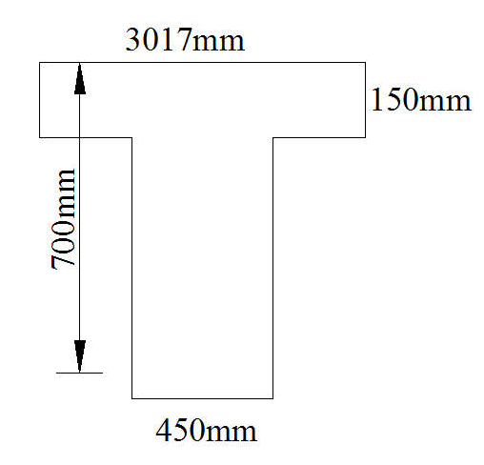
Maximum shear force at B =
= 160kN
Shear force at the hinge at A = = 47.8kN
Factored moment at support B = 1.5x177.8=266.7kNm Factored moment at centre of span= 1.5x222.2=333.3kNm Factored shear force at hinge at A = 1.5x47.8 = 71.7 kN Factored shear force at support B = 1.5x160=240kN DESIGN OF BEAMS
Central section:-
Assume dimensions of the beam are
b_{w} = 450mm, d = 700mm, D_{f} = 150mm
b_{f}= +b_{w} +6D_{f} = +450+(6*150)= 3017mm
=
= 0.011
= 0.36 )(1-0.42x ) = 0.07
hence NA is inside the flange.
Fig-2
333.3x10⁶=0.87x415xAstx700
Ast = 1336.3mm²
Use 4# of 25mm dia bars
Support section:-
Mu =266.7kN-m 266.67x10⁶=0.87x415xAstx700

Slide 56
A_{st}= 1141mm²
Use 4# of 20mm dia bars
DESIGN OF SHEAR REINFORCEMENT:-
Vu = 240kN
=
= 0.76N/mm²
=
= 0.62
Interpolation
0.50 0.48
0.62 ? 0.75 0.56
=0.52N/mm²
V_{us}=240x10³-(0.52x450x700) =76200
76200 = 0.87x415x2x
*700
S_{V} =333mm
Use 2L #8 @ 300c/c
Design of Column
Mu = 266.7 kN-m Vu = 240kN

Slide 57
=
= 0.082
= = 0.044
Referring to the chart given in SP16
= 0.04
P=0.04x20=0.8
Ast= = 0.8x450x = 2160 mm²
Use 4#20 and #8 @ 300 as ties
DESIGN OF HINGE:-
Permissible bearing stress at the hinge = 0.5fck=10N/mm²
Area of hinge = =16000mm²
Area provided = 450*150 16000mm² Working shear at the hinge = 47.8kN Factored shear at the hinge = 71.7kN A_{sv}sin45x0.87x415 = 71.7x10³
A_{sv} = 280.9mm²
Use 4# 12mm dia
Spiral consisting of 10mm dia with 6mm diameter
Design of foundation
Axial load on the column
= 160kN
Weight of column = 0.45 x 0.6x 3.72x 24
= 24kN

Slide 58
Self-weight of foundation 10%
= 16kN
Total load
= 200kN
Moment about the base (M) =47.8*1
Eccentricity e = = =0.239m Breadth of foundation = 6X239=1434mm
= 47.8 kN-m
Provide a foundation of 1mX2m
Intensity of maximum pressure =
= 150kN/m² < 200kN/m²
p
X150=97.5 kN/m²
Total pressure on cantilever portion =
= 86.6 kN
BM, Mu= (86.6*
=45kN-m
Effective depth required =
= 127.6mm
From the shear considerations; double the effective depth say D= 300mm
Design of main reinforcement
45X10⁶=0.87X415XA_{st}X250 (1-
X )
A_{st}=521mm²
Spacing of #12 =
*1000= 217mm
Use #12 @ 200mm c/c in both ways
Distribution steel, Ast== x 1000x300 = 360mm²

Slide 59
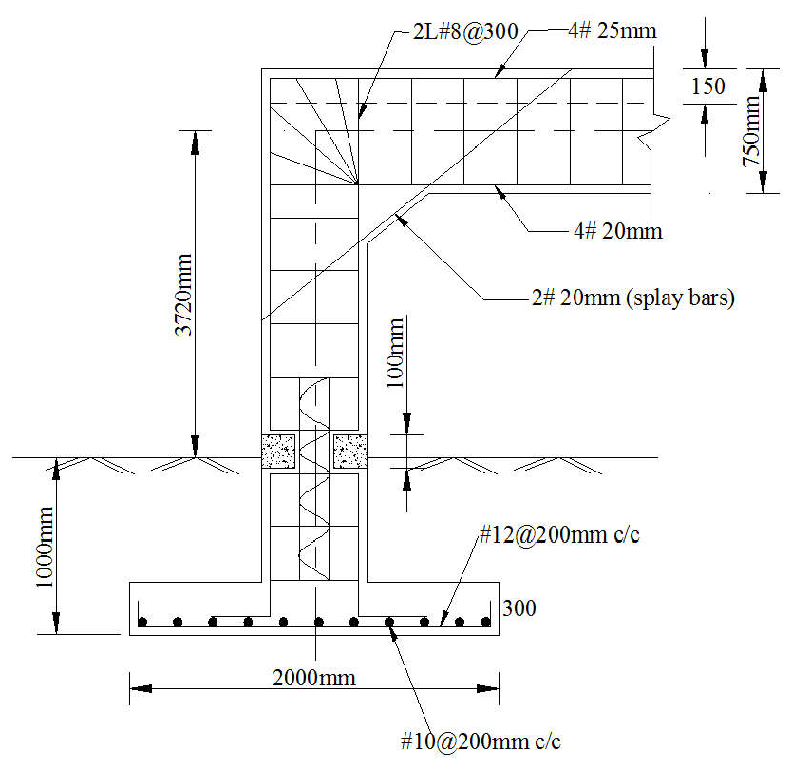
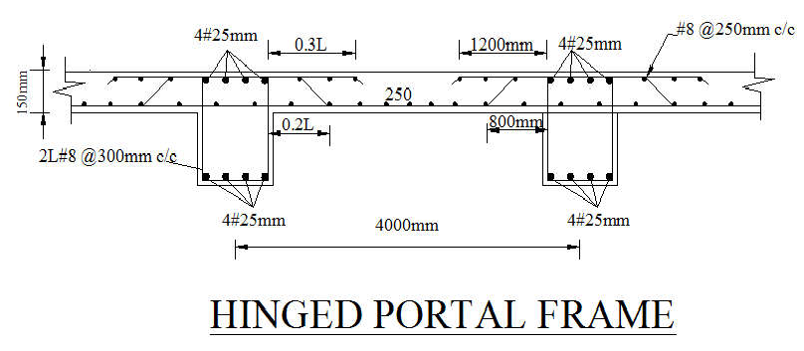
Spacing of #10 =
*1000= 218mm
Use #10 @ 200mm c/c

Slide 60
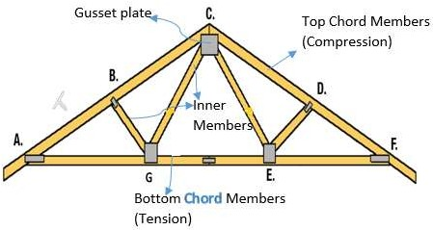
Module 2
Design of Steel Structures Design of Roof Trusses:
Following points are followed while designing the roof truss
Select double angle for top chord and bottom chord members and single angle for inner members.
Provide minimum two number of bolts for the connection in Bolted roof truss.
Take effective length ι e = 0.85 ι
Provide uniform thickness of gusset plate
Select minimum size of angle i.e. ISA 50 x 50 x 6 mm
Design only four member’s i.e.
Outer Maximum Compression Member
Outer Maximum Tension Member
Inner maximum compression member
Inner maximum tension member
1 | P a g e

Slide 61
The Centre line diagram of the steel truss is shown in figure. The magnitude and nature of forces in different members of the truss are given in table. The size of the RC column supporting the truss is 300 x 300 mm. Use M20 concrete for Column.
Design the truss using bolted or welded connection. Also design anchor bolts for an uplift force of 15 KN at each support.
Draw rough sketches of following
Elevation of truss greater than half span.
Enlarged view of apex joint of the truss.
Enlarged view of the left support joint.
D
C
A
E
4 M
F
4M G 4M
AC = CD = DE =EB
B
Member | Force (KN) | Length (m)
AC,EB | -80 KN | 3.46
CD,DE | -70 KN | 3.46
AF,GB | +70 KN | 4
FG | +50 KN | 4
CF,EG | -24 KN | 2
DF,DG | +24 KN | 4
Reaction, Ra = Rb = 50 KN
-ve = Compession, +ve = Tension
2 | P a g e

Slide 62
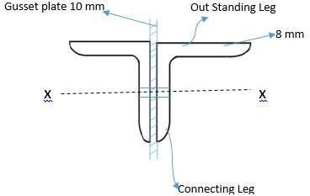
Soln:
1. Design of outer Compression Member ( Top Chord Member) The members are AC, CD,DE and EB
Member AC Member CD
80 KN (C)
70 KN (C)
L = 3.46 m L = 3.46 m
Select maximum force = 80 KN
∴Factored force = 1.5 x 80 = 120 KN Maximum length = 3.48 m
Design the top chord as the compression member using double angle and bolts
i. Selection of Section: Assume fcd = 60 N/mm²
Using
Pd = Ac fcd …………….Page no. 34, IS 800 120 x 10 ³ = Ac x 60
Ac = 2000mm² or 20 cm²
From Steel tables select suitable double angle section.
Let us try 2ISA 70 x 70 x 8mm
∴ Ac = 2116 mm²
Assume gusset plate thickness = 10 mm
3 | P a g e

Slide 63
From steel table rxx = 21.2mm
ryy = 32.9mm ( For 10 mm gap)
∴rmin = 21.2 mm
Length of the member L = 3.46 M = 3460 mm
∴ Effective Length Le = 0.85 L = 0.8 * 3460
= 2941 mm
𝐿𝑒 2941
∴ Slenderness ratio = ƛ = =
21.2
^{𝑟}𝑚𝑖𝑛
ƛ = 138.72
From table 9C (Page 42 IS 800) For 130 -- fcd = 74.2
For 140 -- fcd = 66.2
∴ For 138 – fcd = 67.23 N/mm²
∴ Design Compressive Strength
Pd = Ac * fcd
= 2116 * 67.23
= 142.25 x 10³
Hence Safe.
N > 120 KN
ii. Design of Connection:
Using m-16 Bolts and Grade 5.6 black bolts
d = 16 mm, do = 16 + 2 = 18 mm and fu = 500 N/mm² fu for plate = 410 N/mm²
e = 1.5 * do = 1.5 * 18 = 27 mm say e = 30 mm p = 2.5 *d = 2.5 * 16 = 40 mm
From IS 800, Page 75 Shear strength of Bolt
1 𝑓𝑢𝑏
Vdsb = _{γ}
[ (nn Anb +nsAsb) ]
√3
𝑚𝑏
4 | P a g e

Slide 64
Assume fully threaded bolts and double shear nn = 2 and ns = 0
1 500 𝜋 16²
Vdsb =
[ (2* ∗ 0.78 + 0 ) ]
1.25 √3
4
= 72.43 KN
Similarly Bearing Strength
V dpb= _{γ}
1
[2.5*kb*d*t*fu) … Page 75 IS 800
𝑚𝑏
kb is taken as least of the following
kb =
𝑒
= 0.55
- 0.25 = 0.49
3𝑑𝑜
𝑝
kb =
3𝑑𝑜
kb
₌ 𝑓𝑢𝑏
= 1.21
𝑓𝑢
kb = 1
∴ kb = 0.49
∴ V =
1
[2.5*0.49*16* 8*410) = 51.43 KN or 51.43 x 10³ N
dpb
1.25
∴ Bolt value = 51.43 KN ( Least of shear and Bearing Strength)
𝐹𝑜𝑟𝑐𝑒
120∗10^3
No. of Bolts =
= = 2.3 ≈ 3 Nos
𝐵𝑜𝑙𝑡 𝑉𝑎𝑙𝑢𝑒 51.43∗10^3
Hence adopt 2ISA 70 x 70 x8 mm for top chord.
2. Design of Outer Tension Member (Bottom Chord Member)
The bottom chord members are AF = FG = GB AF = 70 KN (T), L = 4 m
FG = 50 KN (T), L = 4 m GB = 70 KN (T), L = 4 mα
5 | P a g e

Slide 65
Maximum force = 70 KN
∴ Factored force = 1.5 * 70 = 105 KN Maximum Length = 4m
i. Selection of Section:
Using Tdn = ^{𝛼 𝐴𝑛 𝑓𝑢} ………… Page 33 IS 800
^{γ}𝑚𝑙
Here Tdn = Factored Load = 105 x 10^3 N
𝛼 = 0.7 𝑎𝑛𝑑 γ = 1.25
𝑚𝑙
105 x 10^3 = ^{𝐴𝑛 𝑓𝑢}
^{γ}𝑚𝑙
6 | P a g e

Slide 66
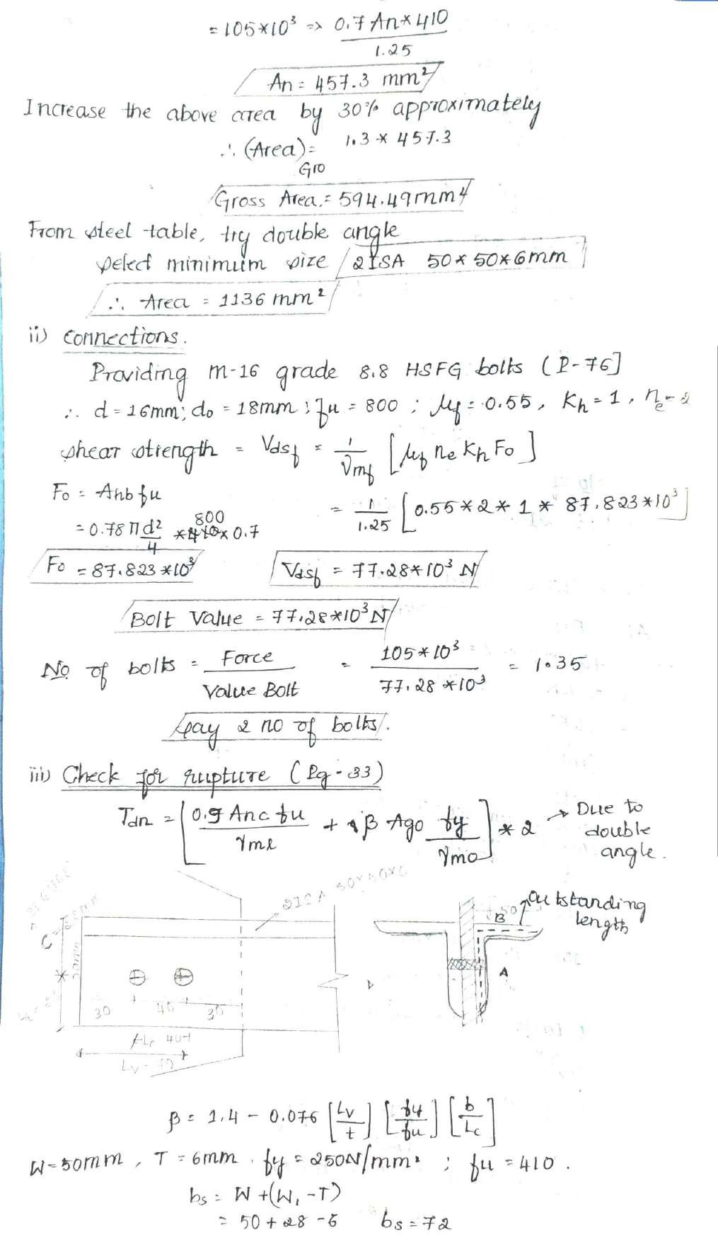

Slide 67
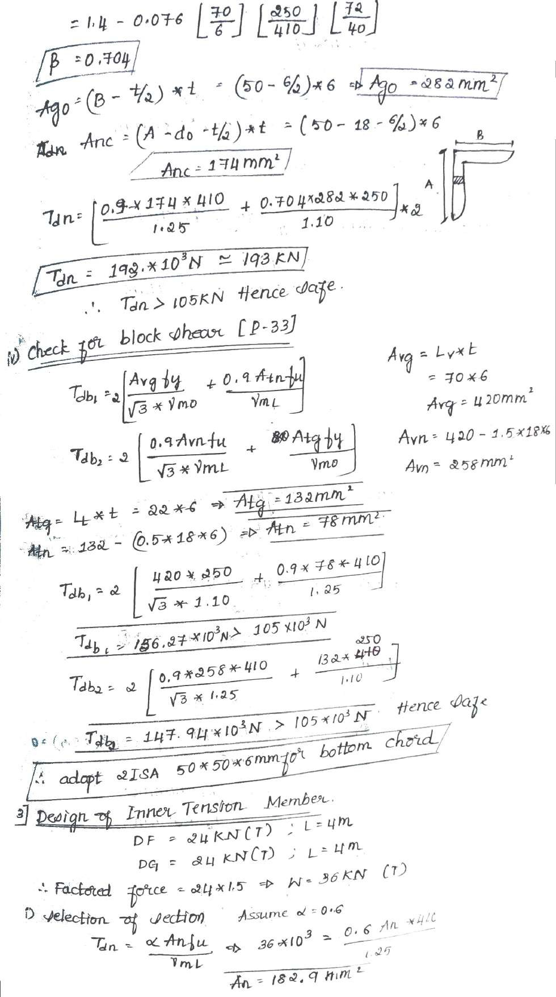

Slide 68
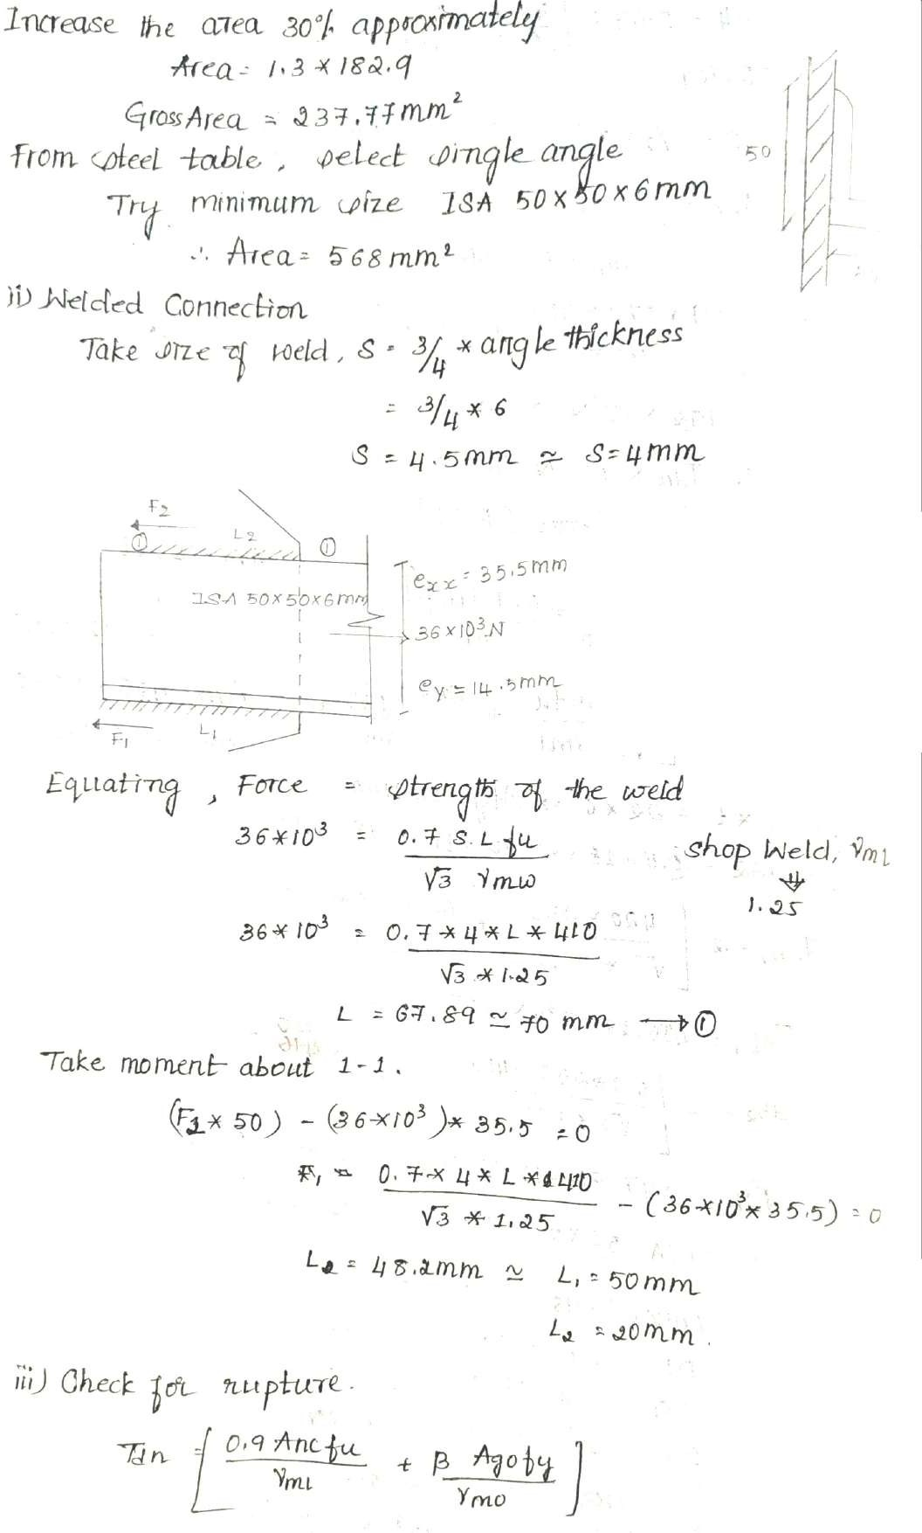

Slide 69
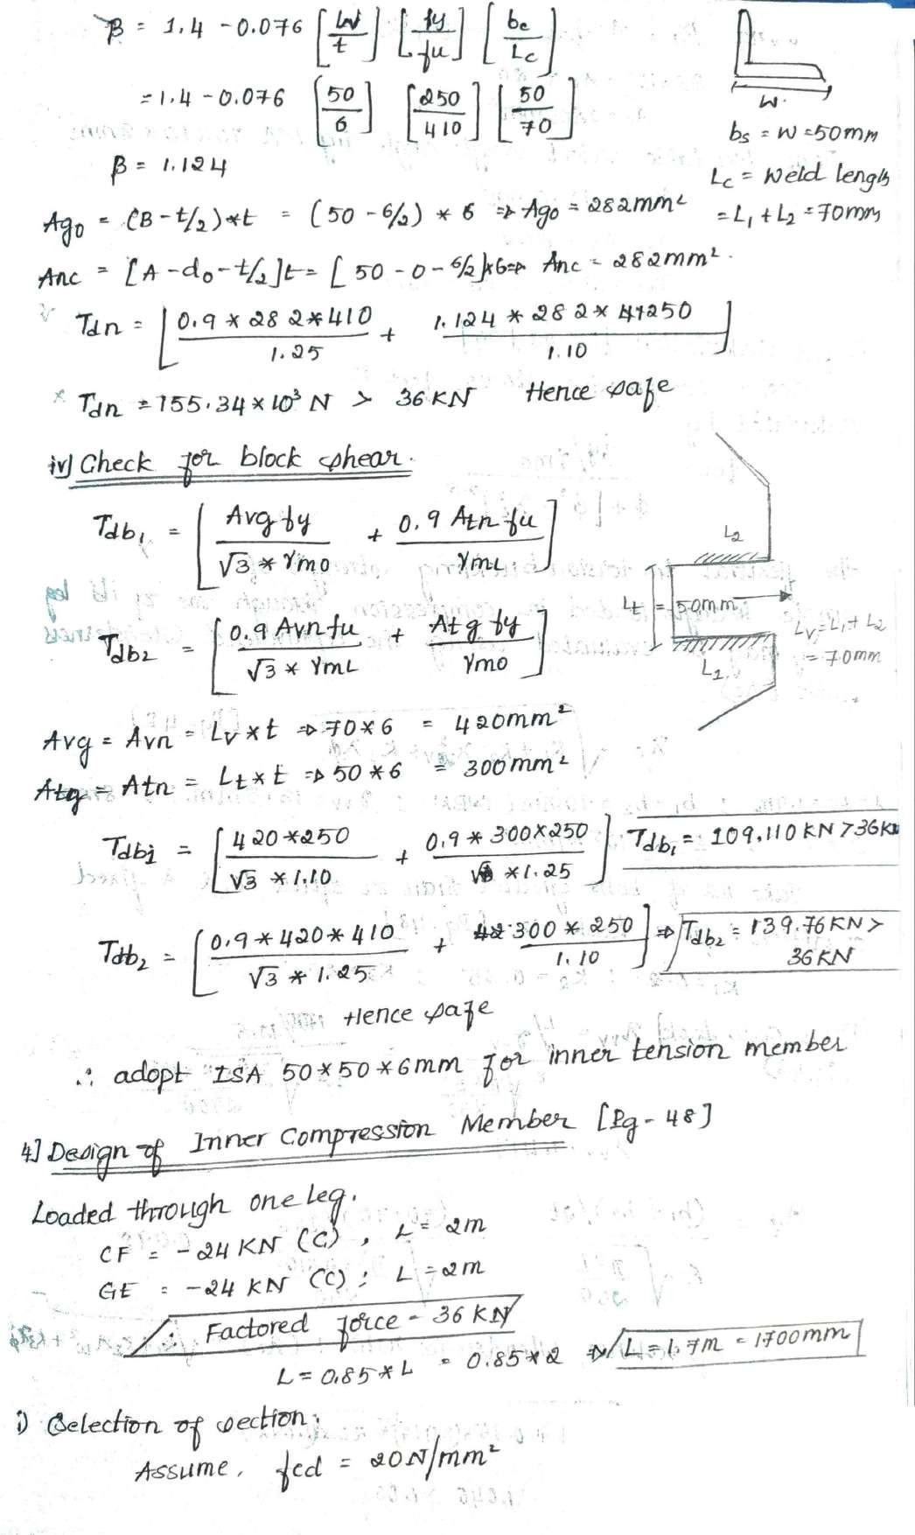

Slide 70
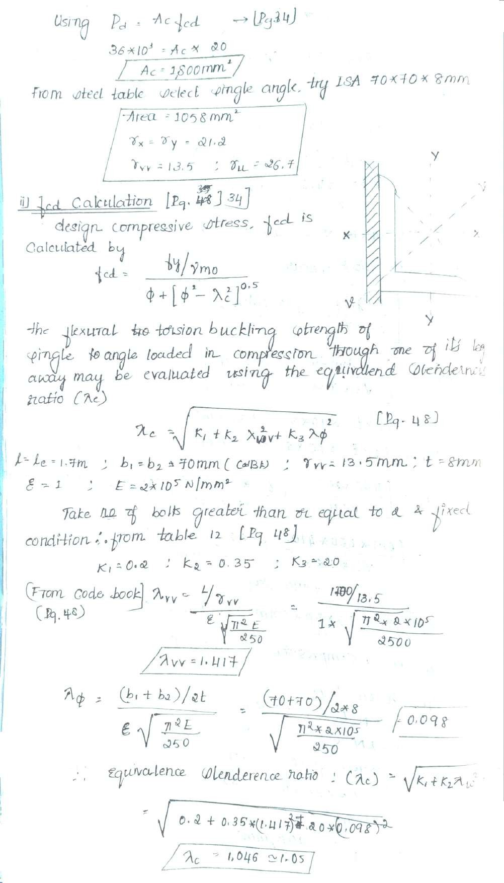

Slide 71
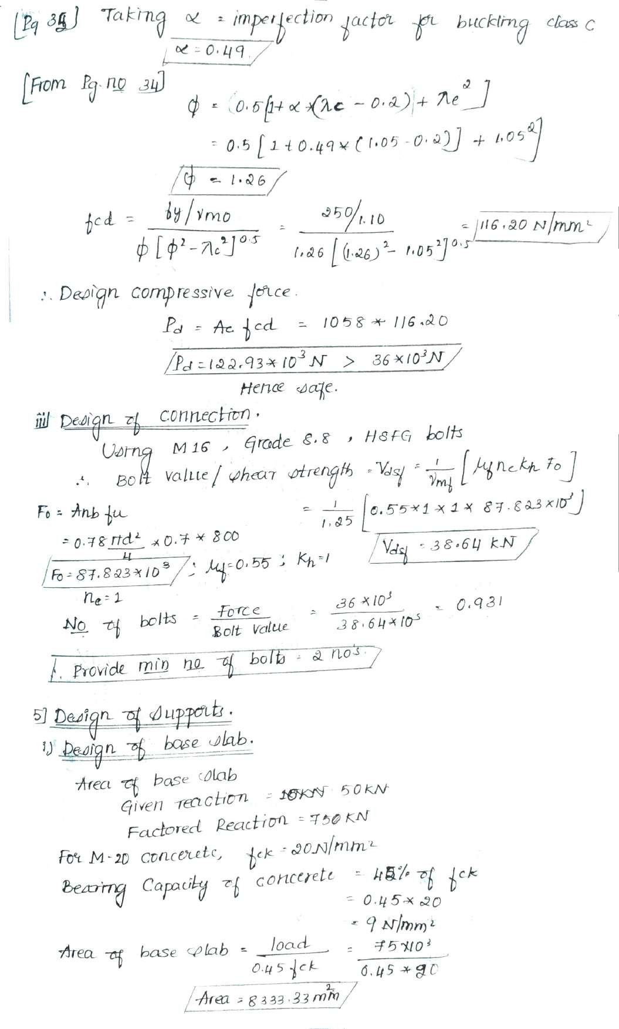

Slide 72
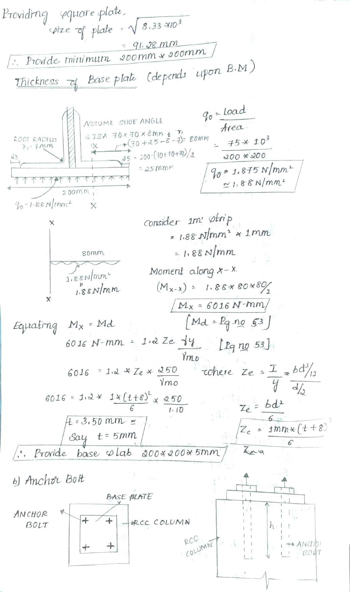

Slide 73
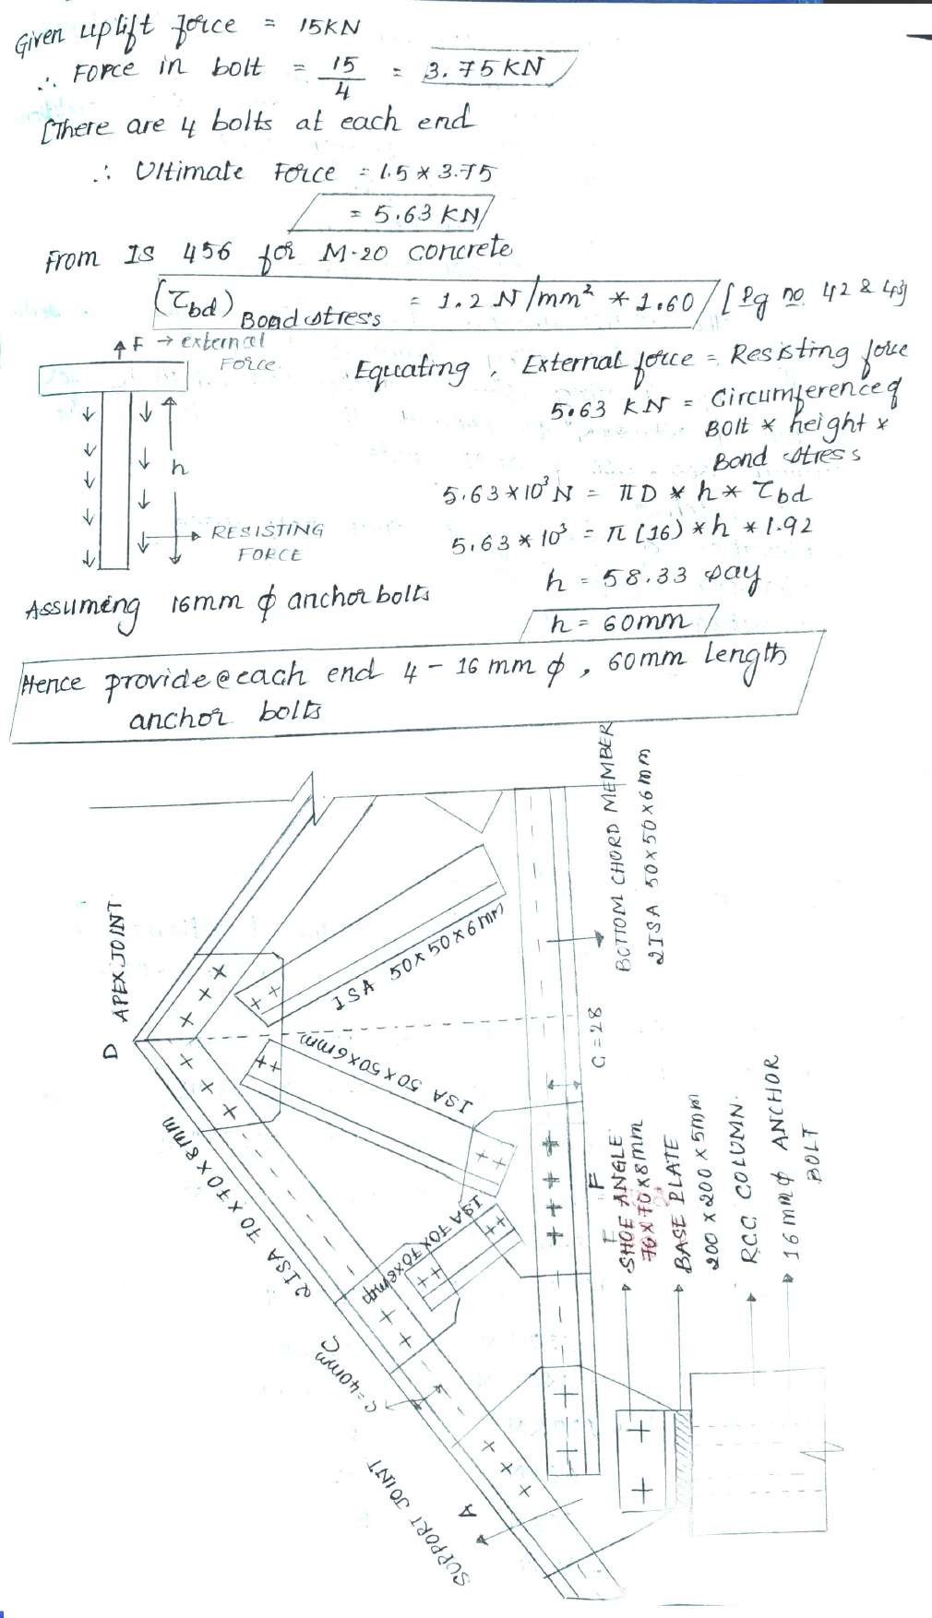

Slide 74
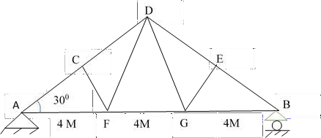
Force in a members as dead load and live load and also wind load is given below. Take tension as positive and compression as negative. Design the truss and support, given upward reaction at support is equal to 180 KN. Uplift pressure 50 KN. Use M-16 bolt for connection.
Draw the sketches of the following
Half elevation of the truss
Enlarged view of apex joint
Enlarged view of end joint & Intermediate joint.
Member | Dead load (KN) | Live load(KN) | Wind load (KN) | Length (m)
AC | +9.4 | -30 | +50.4 | 3.46
CD | -15.7 | -23.8 | +43.4 | 3.46
CF | -6.93 | -10.4 | +19.9 | 2
DF | +3.74 | +5.64 | -11.4 | 4
AF | +17.35 | +26.4 | -42.8 | 4
FG | +10.39 | +15.8 | -21.5 | 4
1

Slide 75
Soln:
1. Load Calculation [ DL + LL and DL + WL]
Member | Dead load + Live load (KN) | Dead Load + Wind Load (KN) | Final Design Load (KN) | Length (m)
AC | -20.6 | +59.80 | Top chord +59.80 (T) -39.5(C) | 3.46
CD | -39.5 | +27.7
CF | -17.33 | +12.97 | Inner Member -17.33 (C) +12.97 (T) | 4
DF | +9.38 | -7.60
AF | +43.75 | -25.45 | Bottom Chord +43.75 (T) -25.45 (C) | 4
FG | +26.19 | -11.11
Design of Top Chord Member:
After the load calculation, select the maximum value
Tension force = 59.8 KN , Factored Force = 1.5 * 59.8 = 89.70 KN Compressive Force = 39.5 KN, Factored Force = 1.5 * 39.5 = 59.25 KN Maximum length = L = 3.46 m
∴ Effective length = Le = 0.85 *3.46 = 2.941 m = 2941 mm
Since tension force is more than compressive force, start the design like a tension member and then check for compressive force.
a. Design of Tension Member:
Using Tdn = ^{𝛼 𝐴𝑛 𝑓𝑢} …………
Page 33 IS 800
^{γ}𝑚𝑙
2

Slide 76
Here Tdn = Factored Load = 89.70 x 10^3 N
𝛼 = 0.6 𝑎𝑛𝑑 γ = 1.25
𝑚𝑙
89.70 x 10^3 = ^{0.6∗ 𝐴𝑛∗410}
1.25
∴ An = 455.792 mm²
Increase the area approximately by 30 %
Vdsf Gross area Ag = 1.3 * 455.792 = 592.54 mm² From Steel table, Select double angle
Taking minimum size that is 2ISA 50 x 50 x 6 mm Area = 1136 mm²
Also rxx = 15.1 mm and ryy = 24.6 mm (For a gap of 10 mm) b. Design of Connections:
Given M 16 bolts, Assume grade 8.8 HSFG bolts
Vdsf = _{γ}
1
[μf ne Kh Fo], μf = 0.55, ne = 2, Kh = 1 and
𝑚𝑓
F =0.7 *fu * An = 0.7*800*
𝜋∗ 16
2
= 87.82 x 10³ N
o
4
V =
1
[0.55 * 2 * 1 *87.823 x10³]
dsf
1.25
Vdsf
= 77.284 KN
Therefore Bolt Value = 77.284 KN
No. of Bolts =
𝐹𝑜𝑟𝑐𝑒 89.71
=
= 1.16 Say 2 nos
𝐵𝑜𝑙𝑡 𝑉𝑎𝑙𝑢𝑒 77.284
∴ Number of bolts = 2 nos.
3

Slide 77
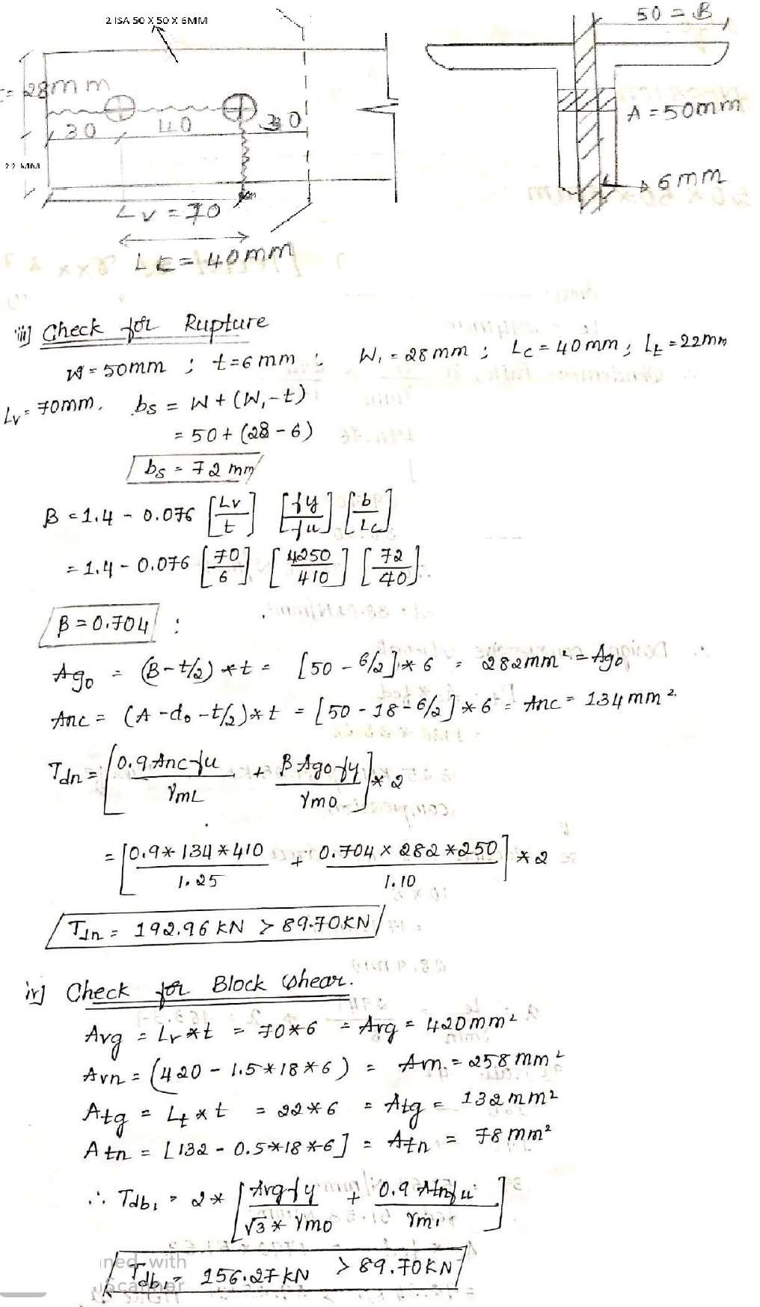
4

Slide 78
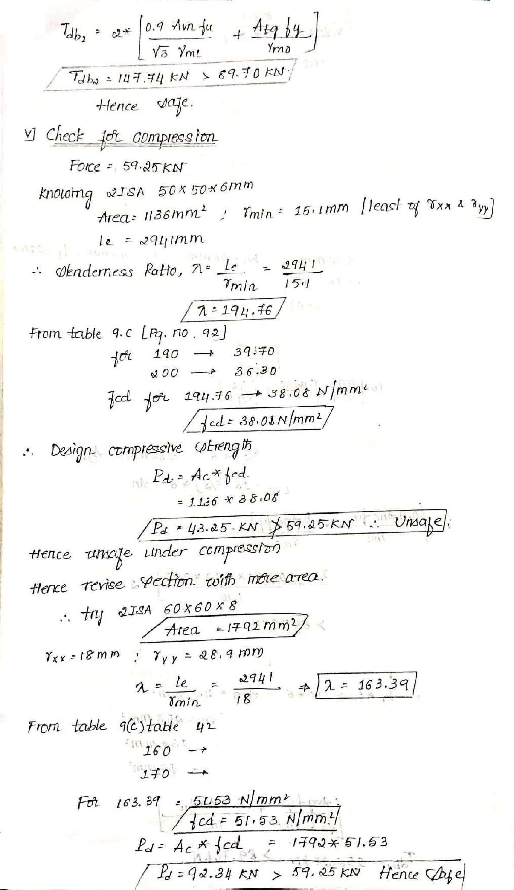
5

Slide 79
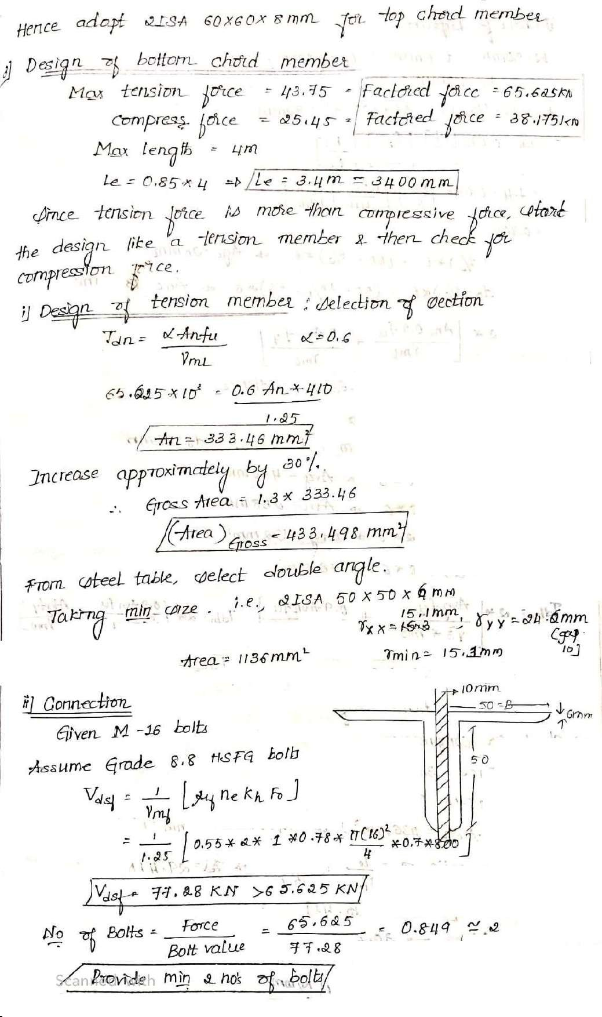
6

Slide 80
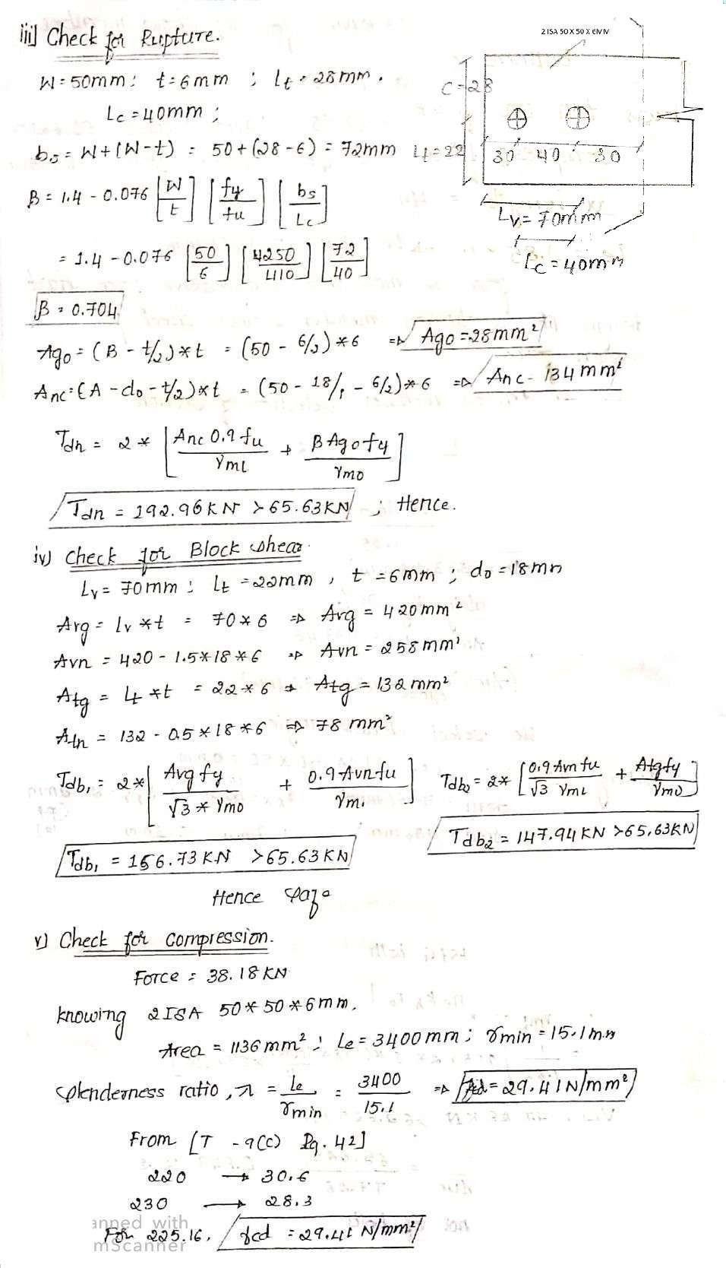
7

Slide 81
8

Slide 82
9

Slide 83
10

Slide 84
11

Slide 85
b. Thickness of Base Plate:
𝐿𝑜𝑎𝑑 270∗ 10^3
q = = = 6.75 mm²
o
𝐴𝑟𝑒𝑎 200 𝑥 200
Considering 1 m strip, qo / meter = 2.25 x 1 = 6.75 N/mm
Moment along x -x
Mx-x = 6.75 *80*80/2 = 21,600 N-mm
Equating Mx-x = Md
= 1.2 Ze
𝑓𝑦
…. Page 53 IS – 800
𝛾𝑚𝑜
21,600 = 1.2 Ze
250
𝐼
1.10
Where Ze = = (bd /12)/(d/2)
3
𝑦
=bd²/6 = (1mm *(t+8)²)/6
21600 = 1.2 (1mm *(t+8)²)/6 ∗
250
1.10
t = ……… mm . … . 𝑚𝑚
∴ Provide base slab 200 mm x 200mm x ………mm
12

Slide 86
c. Anchor Bolts:
Given uplift force = 50 KN Provide 4 bolts at each end.
∴ Force in each bolt = 50/4 = 12.5 KN Ultimate force = 1.4 * 4 = 18.75 KN
From IS 456, for M20 Concrete
(τbd )bond stress = 1.2 N/mm² * 1.60 …….Page No. 43 Equating external force = Resisting force
18.75 KN = Circumference of bolt * Height * Bond Stress
18.75 = π D * h * τbd
18.75 * 10³ = π * 16 * h * 1.2 * 1.6
h = ……… mm ≈ ⋯ … … . 𝑚𝑚 Hence Provide at each end 4-16mm dia,...….. mm length anchor bolts
13

Slide 87
14

Slide 88
15

Slide 89
Roof Truss type 2 – 2nd Problem
2. The forces in the members of the roof truss of an
industrial building are as shown in table. The truss is supported on 400mm thick masonry. End reaction due to dead load + live load is 10.556 KN. Members are to be connected at the joints with 16 mm dia bolts and 8mm thick gusset plate. Design the members and base plate. Assume permissible bearing pressure on masonry = 0.8 Kn/mm² and size of the Shoe angle is 2ISA 75 x 75 x 6mm on each side of the gusset plate.
Members | Force
 | Compression (-ve) KN | Tension (+ve) KN
LoV1,V1V2,V2V3 | -17.4 | 20.9
LoL1, L1L2, L2L3 | -14 | 14.9
V3L2 | -8.7 | 6
V2L2 | -5.3 | 7.4
V2L1 | -6.7 | 4.6
V1L1 | -3.5 | 5
16

Slide 90
Soln:
1. Load Calculation:
Members | Force |  | Final Design Force | Length in m
 | Compression (-ve) KN | Tension (+ve) KN
LoV1,V1V2,V2V3 | -17.4 | 20.9 | Top Chord +20.9 (T) -17.4 (C) | 1.79
LoL1, L1L2, L2L3 | -14 | 14.9 | Bottom Chord +14.9 (T) -14 (C) | 3.10
V3L2 | -8.7 | 6 | Inner Member +8.7 (C) -7.4 (T) | 3.10
V2L2 | -5.3 | 7.4
V2L1 | -6.7 | 4.6
V1L1 | -3.5 | 5
Design Top Chord Member:
Since tension force is more than compressive force, Design the member as tension member and check for Compressive load Carrying Capacity
Desing of Bottom Chord Member:
Since tension force is more than compressive force, Design the member as tension member and check for Compressive load Carrying Capacity
Desing of Inner Member:
Since Compressive force is more than tension force, Design the member as Compressive member and check for Tension load Carrying Capacity
17

Slide 91
Design of Base Plate: ( Design of Support)
Area of Base Plate
Thickness of Base Plate c . Anchor Bolts
3. Design a roof truss shown in figure. The forces in the members of the truss due to dead load, live load and wind load are tabulated below.
18

Slide 92
Soln:
1. Load Calculation:
Members | DL + LL (KN) | DL+WL (KN) | Design Force (KN) | Length in M
AB | +36.17 | -22.95 | Top Chord +36.17 (C) -23.85 (T) | 1.863
BC | +29.24 | -20.44
CD | +30.31 | -23.85
DE | -12.83 | +9.57 | Inner Member -12.83 (C) +9.57 (T) | 3.33
EC | +6.95 | -5.65
EB | +6.95 | -6.38
EA | -32.21 | +18.84 | Bottom Chord - 32.21 (C) + 18.84 (T) | 3.33
EF | -19.30 | +7.94
Design of Top Chord Member
Design of Bottom Chord Member
Design of Inner Member
19

Slide 93
Welded Plate Girder and its Components:
Page 1 of 16

Slide 94
Module 2
Design of Welded Plate Girder
Plate girders are deep built-up beams used in bridges, building and industrial structure. For heavy loads and long spans, plate girders are substituted for rolled beams. A Plate girder consists of web plate with stiffeners if required and top & bottom flanges.
Components of Welded Plate Girders:
Following are the various components of plate girder as shown in the figure.
Flange plates: Top and Bottom Plates to take the bending moment.
Web Plate: To take the shear force.
Vertical or Transverse Stiffeners: Provided along the span to increase web buckling strength.
Horizontal Stiffeners or Longitudinal stiffeners: Provided in areas of very high moments.
End or Bearing Stiffeners: Provided at Concentrated loads and reactions points to transfer the loads.
Splices: They are provided if necessary continuity required in the web & flanges.
Page 2 of 16

Slide 95
Following are the different steps used in design of Welded plate Girder:
Design of mid span
Load Calculation
Girder Dimensions
Web Depth
Web Thickness
Flange width
Flange Thickness
Check for moment of resistance
Check for Shear
Welded connection between flange and Web
Curtailment of flange plate
Design of Intermediate Stiffeners (IS)
Design of End Bearing Stiffeners (EVS)
Page 3 of 16

Slide 96
Page 4 of 16

Slide 97
Page 5 of 16

Slide 98
Page 6 of 16

Slide 99
Page 7 of 16

Slide 100
Page 8 of 16

Slide 101
Page 9 of 16

Slide 102
Page 10 of 16

Slide 103
Page 11 of 16

Slide 104
Page 12 of 16

Slide 105
Page 13 of 16

Slide 106
Page 14 of 16

Slide 107
Page 15 of 16

Slide 108
Page 16 of 16

